Slide 1
Hedera Network NFT Market Analysis
Hedera Network

Slide 2
Stage
Hedera Network Overview
Hedera NFT Market Data Analysis
Royalty Fees For Hedera NFT
Data Processing for Hedera Network and NFT Market
还有啥
还有啥

Slide 3
Hedera Network Overview
A decentralized public ledger using a leaderless, asynchronous Byzantine Fault Tolerant (aBFT) hashgraph consensus algorithm.

Slide 4
Introduction to Hedera Network
Decentralized Public Ledger
Utilizes leaderless, asynchronous Byzantine Fault Tolerant (aBFT) hashgraph consensus.
Compatible with Ethereum Virtual Machine (EVM).
Development Features
Supports smart contracts similar to ERC20, ERC721, and ERC1155 via Hedera Token Service Standards.
Community and Establishment
Established in 2018.
X account: 354K followers (as of Sep 2024).
Reddit community: 39K members.
Network Structure
Dozens of consensus nodes from enterprises, universities, and Web3 projects
Nodes identified in format: 0.0.X (shard and realm numbers).
Notes:
Hedera Network is a decentralized public ledger known for its unique hashgraph consensus algorithm, which is leaderless and asynchronous Byzantine Fault Tolerant (aBFT). This ensures robust security and efficiency.
Hedera is EVM-compatible, meaning developers can use its consensus service APIs to create applications similar to those on Ethereum. Through the Hedera Token Service Standards, it supports smart contracts akin to Ethereum's ERC20, ERC721, and ERC1155, providing flexibility and familiarity for developers.
Founded in 2018, Hedera has grown significantly. As of September 2024, its official X account boasts 354K followers, and its Reddit community has 39K members, reflecting its active and engaged user base.

Slide 5
NFT Fees on Hedera
Standardized NFT Interfaces
Minting and trading with native royalty functions.
Fees configured for revenue from NFT transactions.
Fee Structure
Fixed fees in USD, paid in HBAR (Hedera's native currency).
Hedera Transaction Fees
Create NFT collection: $1.00
Associate collection with account: $0.05
Mint NFT: $0.02
Include royalty fee: $0.01
Transfer NFT: $0.001
Notes:
Hedera offers standardized interfaces for minting and trading NFTs. Unlike Ethereum, Hedera includes a native royalty function that allows creators to easily configure fees and earn revenue from their NFT transactions. NFT fees on Hedera are fixed, priced in USD, and paid in HBAR, its native currency.
For example, creating an NFT collection on Hedera costs 1 USD in HBAR. In comparison, deploying a smart contract on Ethereum via OpenSea costs about 9.05 USD. Additionally, exchanging NFTs on Hedera costs just 0.001 USD, whereas buying an NFT on Ethereum's mainnet via OpenSea incurs a network fee of approximately 0.5 USD.

Slide 6
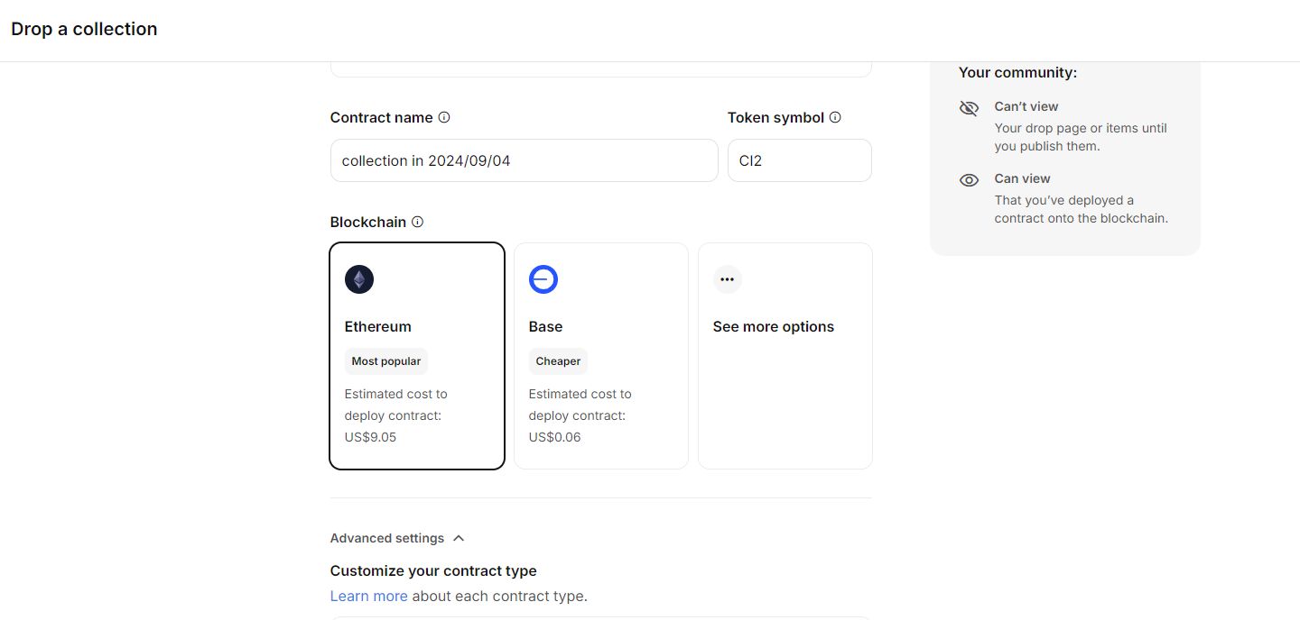
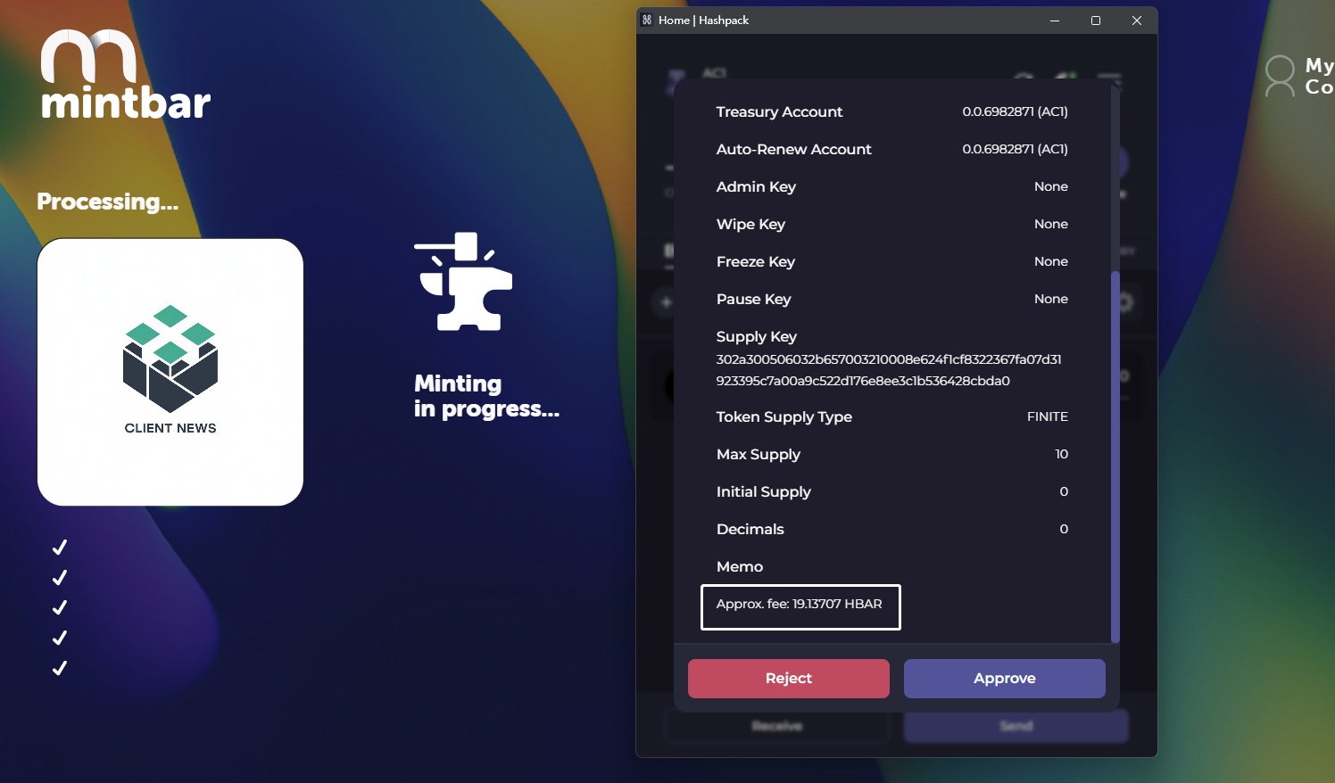
NFT Fees on Hedera
Create an NFT collection on MintBar standard Hedera contract
(19.1370HBAR ≈ 1.0005USD)
Create an NFT collection on OpenSea ERC-1155 Ethereum contract

Slide 7
Hedera NFT Market Brief Summary
Hedera NFT Activity (as of Aug 15, 2024)
NFTs Minted: 5,770,946
NFT Transfers: 5,837,419
Total Transaction Volume: $17,638,310
Market Capitalization
HBAR: $1,868,593,439
Recent Transaction Volume
Last 30 Days: $69,606.3
Last Week: $6,376.8
Decrease of 71.5% from the previous week
Notes:
Hedera stands out for NFT applications and projects due to its low, fixed fees, immutable royalties, scalable transactions, and carbon-negative footprint. These features make it a unique and attractive option compared to traditional blockchain networks.
As of August 15, 2024, the Hedera network has seen significant activity:
5,770,946 NFTs minted
5,837,419 transfers
Total estimated transaction volume: $17,638,310
The estimated market capitalization of HBAR, Hedera's native currency, is approximately $1,868,593,439.
Over the past thirty days, the estimated transaction volume is $69,606.3. In the past week alone, the volume was $6,376.8, although this represents a 71.5% decrease from the previous week.

Slide 8
Hedera NFT Market Data Analysis
Ethereum has a larger market size, higher liquidity, and more participants, but Hedera offers unique advantages in terms of fees and scalability.

Slide 9
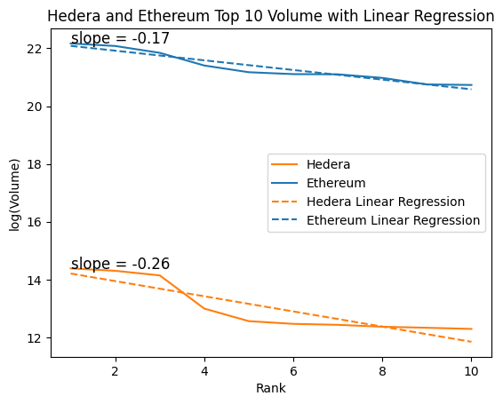
Top NFT Projects by Transaction Volume on Hedera
Rank | Project | Avg. Price | Volume | Traders | Sales
1 | Dead Pixels Ghost Club | $406.57 | $1.77M | 1.98k | 4.48k
2 | Earthlings.land | $305.18 | $1.63M | 3.92k | 15.28k
3 | HANGRY BARBOONS | $249.66 | $1.39M | 1.81k | 5.85k
4 | HGraph Punks | $193.44 | $441.12k | 1.06k | 1.86k
5 | Golden Banana Coin | $467.11 | $285.34k | 504 | 516
6 | Dead Pixels Ghost Pass | $578.52 | $259.93k | 453 | 455
7 | Warsome Wizards | $88.51 | $251.35k | 506 | 2.3k
8 | Creamies Collection | $254.34 | $235.29k | 468 | 985
9 | HashPack Special Collection | $23.30 | $227.1k | 5.86k | 14.43k
10 | Koala Klub Gen 1 | $186.02 | $218.15k | 624 | 1.02k
Top 10 NFT Projects by Transaction Volume on the Hedera
Rank | Collection Name | Avg. Price | Volume | Traders | Sales
1 | Bored Ape Yacht Club | $108.23k | $4.25B | 19.99k | 58.87k
2 | CryptoPunks | $109.34k | $3.89B | 9.33k | 30.32k
3 | Mutant Ape Yacht Club | $19.84k | $3.07B | 42.56k | 147.41k
4 | Azuki | $22.38k | $1.98B | 23.8k | 97.56k
5 | Meebits | $22.74k | $1.57B | 18.87k | 51.12k
6 | Art Blocks | $3.89k | $1.47B | 62.86k | 273.79k
7 | Otherdeed for Otherside | $4.51k | $1.46B | 59.3k | 217.45k
8 | Terraform by Mathcastles | $27.03k | $1.29B | 8.08k | 35.48k
9 | CLONE X - X TAKASHI MURAKAMI | $12.79k | $1.03B | 26.43k | 80.66k
10 | Pudgy Penguins | $10.85k | $1.01B | 23.28k | 94.68k
Top 10 NFT Projects by Transaction Volume on Ethereum
Notes:
By using data from DappRadar.com, we can analyze the performance of Hedera's top 10 NFT collections. This includes metrics such as price, market capitalization, transaction volume, and participant count.
The data reveals that Hedera's NFT market is smaller compared to mainstream markets like Ethereum and Solana. It has fewer participants and lower liquidity.
Figure illustrates that the trading volume trends of the top 10 projects on both Hedera and Ethereum are somewhat similar as the project size ranking changes. Specifically, the linear regression slope is -0.17 for Ethereum and -0.26 for Hedera.

Slide 10
NFT Average Holding Period on the Hedera Network
Project | Mean Gap Time | Median Gap Time | Standard Deviation of Transfer Time | Minimum Transfer Time | Maximum Transfer Time | 25% Quantile | 50% Quantile | 75% Quantile | Total Transfer num
Dead Pixels Ghost Pass | 63.92 | 9.46 | 114.13 | <0.01 | 788.60 | 0.35 | 9.46 | 77.71 | 63.92
Koala Klub | 24.74 | 1.92 | 64.72 | <0.01 | 692.10 | 0.03 | 1.92 | 20.69 | 669
Warsome Wizards | 47.20 | 1.69 | 95.63 | <0.01 | 759.62 | 0.03 | 1.69 | 32.82 | 26067
Golden Banana Coin | 77.21 | 15.46 | 129.83 | <0.01 | 721.56 | 1.27 | 15.46 | 83.94 | 1703
HANGRY BARBOONS | 70.73 | 7.78 | 119.36 | <0.01 | 681.13 | 0.65 | 7.78 | 87.43 | 15879
Hotdog Hustle | 59.37 | 0.46 | 113.03 | <0.01 | 567.43 | 0.00 | 0.46 | 44.13 | 333
HGraph Punks | 31.37 | 2.60 | 83.23 | <0.01 | 959.32 | 0.39 | 2.60 | 28.18 | 3247
Dead Pixels Ghost Club | 49.05 | 3.04 | 105.23 | <0.01 | 802.06 | 0.04 | 3.04 | 39.89 | 17019
HashPack Special Collection | 68.14 | 28.84 | 92.52 | <0.01 | 491.98 | 0.58 | 28.84 | 104.18 | 37284
NFT Projects by Average Holding Period on the Hedera
Notes:
We analyzed several popular projects using Consensus Timestamp data from Hedera's NFT transactions. We excluded transfers with a zero interval, considering the first transfer after minting as the start of the holding period. Our calculations include the average, median, standard deviation, minimum, maximum, and quantiles of holding periods in days for tokens from the top ten NFT projects across different accounts.

Slide 11
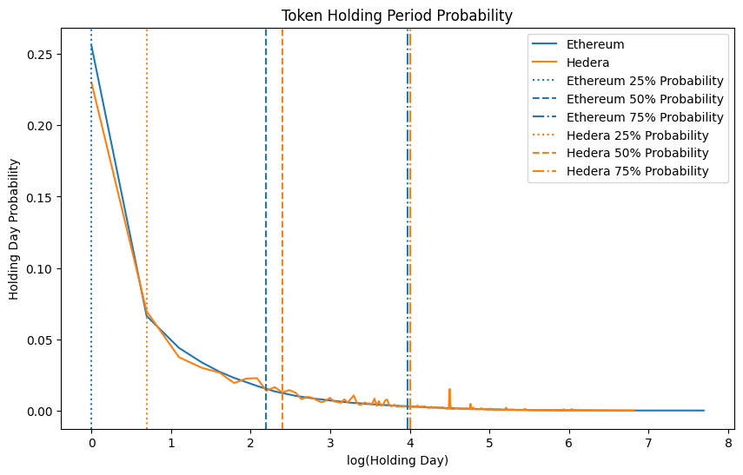
NFT Average Holding Period on the Hedera Network
Collection Name | Mean Gap Time | Median Gap Time | Standard Deviation of Gap Time | Minimum Gap Time | Maximum Gap Time | 25% Quantile | 50% Quantile | 75% Quantile | Total Transfer Num
Pudgy Penguins | 57.46 | 2.87 | 144.94 | <0.01 | 1122.46 | 0.28 | 2.87 | 25.37 | 72260
Mutant Ape Yacht Club | 42.62 | 0.95 | 119.81 | <0.01 | 1098.73 | 0.13 | 0.95 | 16.40 | 119646
Azuki | 40.67 | 1.29 | 111.38 | <0.01 | 953.39 | 0.15 | 1.29 | 15.54 | 78528
Doodles | 49.71 | 1.55 | 127.81 | <0.01 | 1049.43 | 0.19 | 1.55 | 26.51 | 57666
Bored Ape Yacht Club | 80.41 | 5.02 | 186.25 | <0.01 | 1215.59 | 0.40 | 5.02 | 49.50 | 45512
CloneX | 42.13 | 0.92 | 116.08 | <0.01 | 990.45 | 0.14 | 0.92 | 16.89 | 68163
The Otherside | 31.71 | 0.61 | 90.04 | <0.01 | 857.65 | 0.13 | 0.61 | 8.54 | 150170
Beanz | 30.61 | 1.32 | 83.04 | <0.01 | 882.50 | 0.16 | 1.32 | 14.69 | 119710
NFT Projects by Average Holding Period on Ethereum
Notes:
It's important to note that due to non-standard function transfers in the data, these figures are approximate estimates. Most popular projects on Hedera see their first transfer within a month of minting, with transfer frequency decreasing over three to six months. In contrast, Ethereum projects often see transaction frequencies extending over a year.
We also analyzed transaction data from both Hedera and Ethereum to determine the Token Holding Period Probability as of September 2024. Figure shows that Hedera has a higher probability of longer holding periods compared to Ethereum.

Slide 12
NFT Token Concentration on the Hedera Network
Collection Name | History Holders Num | Current Holders Num | Max holding Num | Top 10 holding Sum | Total Mint
Creamies | 626 | 96 | 593 | 1001 | 1111
Dead Pixels Ghost Pass | 769 | 319 | 293 | 402 | 799
Koala Klub | 189 | 66 | 22 | 63 | 100
Warsome Wizards | 773 | 398 | 623 | 2002 | 4413
Golden Banana Coin | 901 | 265 | 26 | 168 | 444
HANGRY BARBOONS | 3089 | 884 | 285 | 1257 | 4444
Hotdog Hustle | 125 | 80 | 13 | 90 | 199
HGraph Punks | 714 | 310 | 30 | 134 | 512
Dead Pixels Ghost Club | 2971 | 1129 | 549 | 1099 | 3900
HashPack Special Collection | 25029 | 16873 | 1006 | 5782 | 29935
NFT Projects by Token Concentration on the Hedera
Collection Name | History Holders Num | Current Holders Num | Max holding Num | Top 10 holding Sum | Total Mint
Pudgy Penguins | 27961 | 5190 | 183 | 859 | 8888
Mutant Ape Yacht Club | 65801 | 11601 | 389 | 1988 | 19497
Azuki | 30761 | 4154 | 346 | 1544 | 10000
Doodles | 31358 | 4201 | 2874 | 3598 | 10000
Bored Ape Yacht Club | 35282 | 5414 | 281 | 1383 | 10000
CloneX | 37429 | 9505 | 534 | 1639 | 19602
The Otherside | 101588 | 15008 | 54577 | 70709 | 100000
Beanz | 39363 | 7668 | 678 | 2722 | 19950
NFT Projects by Token Concentration on Ethereum
Notes:
The Whale Concentration Index (WCI) and Unique Holder Ratio are crucial metrics for understanding the distribution of an NFT project. These metrics are strongly negatively correlated and are especially important for evaluating limited edition collections.
We selected several popular projects and used the current month as the cutoff date to compile data on the total number of accounts that have historically held the tokens, the total number of current holders, the maximum number of tokens held by a single account, and the number of tokens held by the top ten accounts.
Comparing the data from both Hedera and Ethereum, we see that most popular NFTs on the Hedera chain have lower participation levels than those on Ethereum. However, the active user engagement for certain projects on Hedera is comparable to prominent Ethereum projects, and there is a notable similarity in their whale concentration metrics.

Slide 13
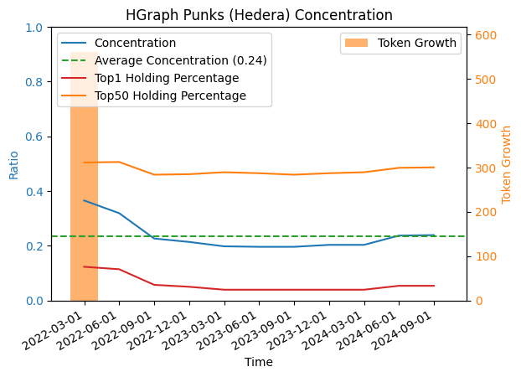
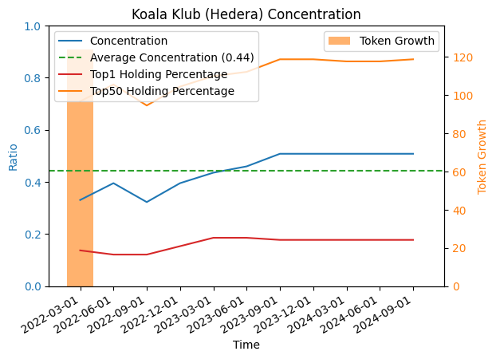
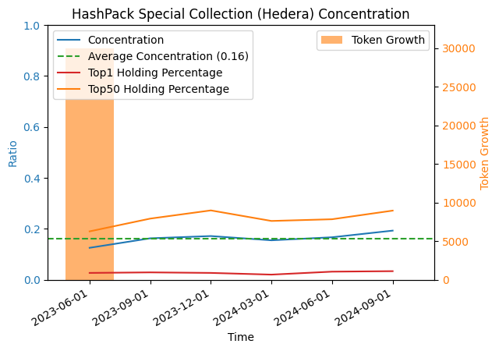
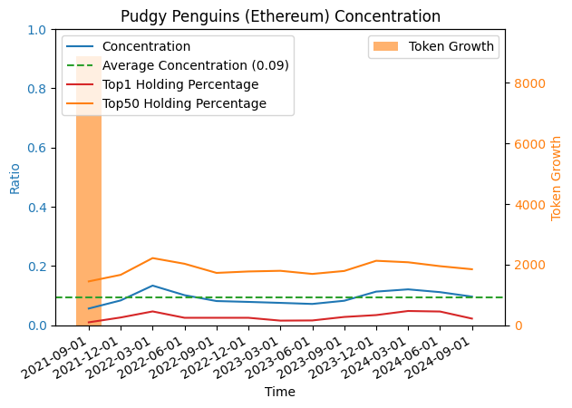
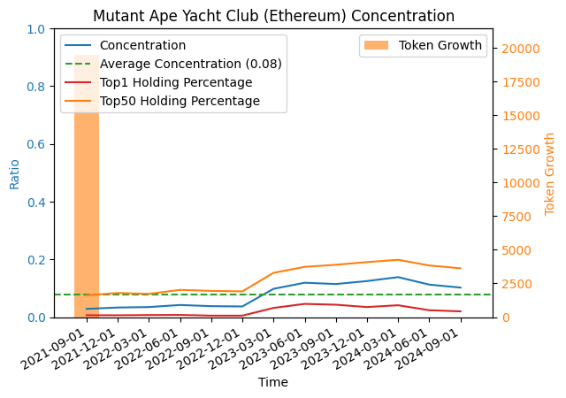
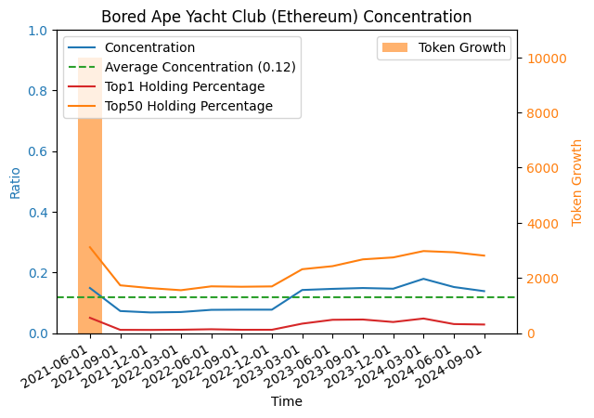
NFT Token Concentration on the Hedera Network
Hedera and Ethereum's three longest running Top projects
Notes:
We also compared the three oldest projects from the selected popular projects on both chains. As shown in Figure, Hedera exhibits a higher concentration compared to Ethereum. However, it's important to note that the total number of mints for popular projects on Hedera is lower than that of popular projects on Ethereum, which may influence the concentration results.

Slide 14
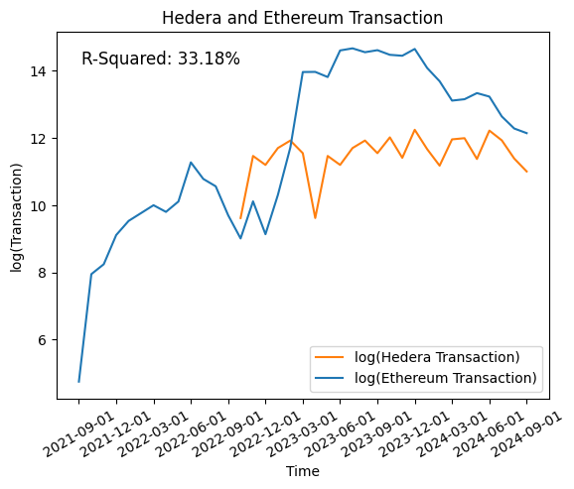
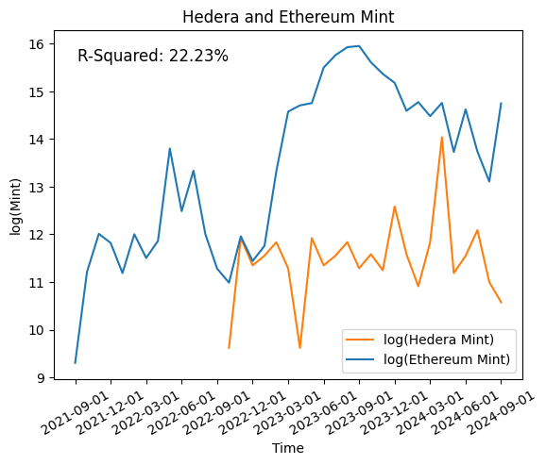
Overall Transaction Data in Hedera
Chain | Total Transactions | Total NFT Projects | Total NFTs（at least once traded）
Hedera | 4,083,715 | 25,811 | 4,737,976 / 2,409,103
Ethereum | 46,663,817 | 75,389 | 200,055,306 / 23,975,886
Transaction Statistics in Hedera and Ethereum
Hedera and Ethereum Mint/Transaction contrast
Notes:
When transferring an NFT from one account to another, the sending party receives a record of fungible tokens from the receiving party, which we define as a "transaction" record.
By analyzing Hedera's transaction data, we can gather statistics such as the total number of transactions, the total number of projects, the number of tokens traded at least once, and the number of NFTs held by addresses.
Comparing this with Ethereum, Hedera has around 4 million transactions, which is about 10% of Ethereum's total. In terms of projects, Hedera represents 33% of Ethereum's total. Of all NFTs minted on Hedera, 50% have been traded, compared to only 11% on Ethereum.

Slide 15
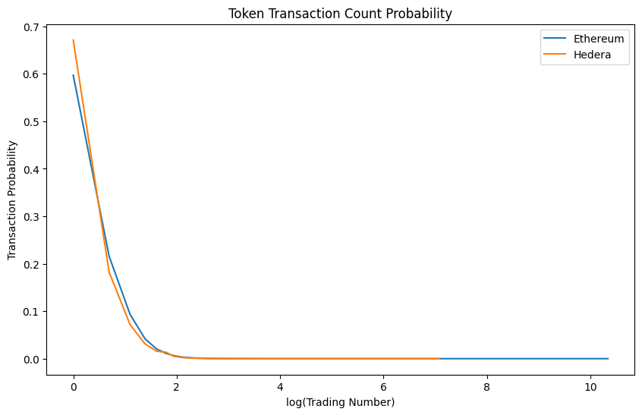
Overall Transaction Data in Hedera
Chain | Average NFTs per Address | Top 10% Address NFT Share | Herfindahl-Hirschman Index
Hedera | 3.86 | 71.65% | 0.0011
Ethereum | 11.72 | 14.48% | 0.0004
NFTs Holding Statistics in Hedera and Ethereum
Chain | num=1 | num=2 | 3≤num≤10 | 10< num≤100 | 100< num
Hedera | 67.1141% | 18.2404% | 14.2389% | 0.4038% | 0.0028%
Ethereum | 59.7041% | 21.5892% | 18.0776% | 0.6110% | 0.0180%
NFTs Transaction Count Probability in Hedera and Ethereum
Hedera and Ethereum Single Token Transaction Count Probability
Notes:
For addresses holding NFTs, the average number per address on Hedera is 3.86, while on Ethereum it's 11.72. The top 10% of addresses on Hedera hold 14.48% of total NFTs, whereas on Ethereum, it's 71.65%.
The Herfindahl-Hirschman Index (HHI) shows Hedera at 0.0004 and Ethereum at 0.0011, indicating high decentralization. However, multiple addresses might belong to the same entity, which could affect the validity of these indices.

Slide 16
Marketplaces Volume on the Hedera Network
Rank | Market | Avg Price ($) | Num of Traders | Sales | Volume ($)
1 | Zuse Market | 81.4 | 12.5k | 136.57k | 11.47M
2 | SentX | 63.77 | 12.33k | 80.6k | 5.18M
3 | Hash Axis | 29.44 | 2.51k | 23.82k | 641.98k
4 | NFTier | 7.1 | 8.85k | 57.94k | 340.44k
Top 4 Marketplaces by Transaction Volume on the Hedera
Rank | Market Name | Avg Price ($) | Num of Traders | Volume ($)
1 | OpenSea | 967.68 | 3.04M | 35.84B
2 | Blur | 1830 | 428.63k | 10.89B
3 | LooksRare | 8770 | 157.94k | 4.86B
4 | CryptoPunks | 111780 | 8.85k | 3.38B
5 | X2Y2 | 679.95 | 223.05k | 1.35B
6 | Rarible | 893.98 | 119.57k | 311.92M
7 | SuperRare | 13150 | 6.1k | 244.54M
8 | Magic Eden | 3550 | 34.24k | 238.32M
9 | Foundation | 2260 | 42.95k | 184.03M
10 | Decentraland | 2150 | 20.95k | 166.36M
Top 10 Marketplaces by Transaction Volume on Ethereum
Notes:
Through a comprehensive review of third-party data sources, we have identified that the primary marketplaces for Hedera NFTs are Zuse Market and SentX. These platforms have emerged as central hubs for NFT trading within the Hedera ecosystem.
Examining the nature of NFTs traded on these marketplaces, it is evident that the majority are digital collectibles. These are often valued for their uniqueness and digital scarcity rather than any intrinsic or tangible assets.
This observation aligns with a growing discourse in the academic community. Some scholars have raised concerns about the speculative nature of digital collectibles, arguing that without tangible assets to underpin their value, these NFTs may be more vulnerable to market volatility and speculative bubbles.
This issue is particularly pronounced in smaller blockchain markets like Hedera, where lower liquidity and fewer participants can exacerbate these risks. This can lead to greater price instability and higher risk exposure for users.
As the Hedera NFT market continues to evolve, these factors underscore the importance of cautious engagement and thorough due diligence for both collectors and investors.

Slide 17
Royalty Fees For Hedera NFT
Hedera Network natively supports NFT royalty fees, which are crucial for incentivizing creators and boosting market activity.

Slide 18
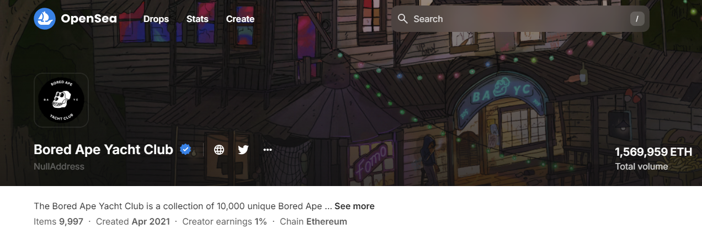
Royalty Fee For Hedera NFT
Natively supports NFT royalty fees
Essential for incentivizing creators and boosting market activity.
Compatible with Ethereum Virtual Machine (EVM).

Slide 19
HEDERA DATA API

Slide 20
Content
Api Usage
Api list select
API
Data collection
Data structure comparison
Result overview

Slide 21
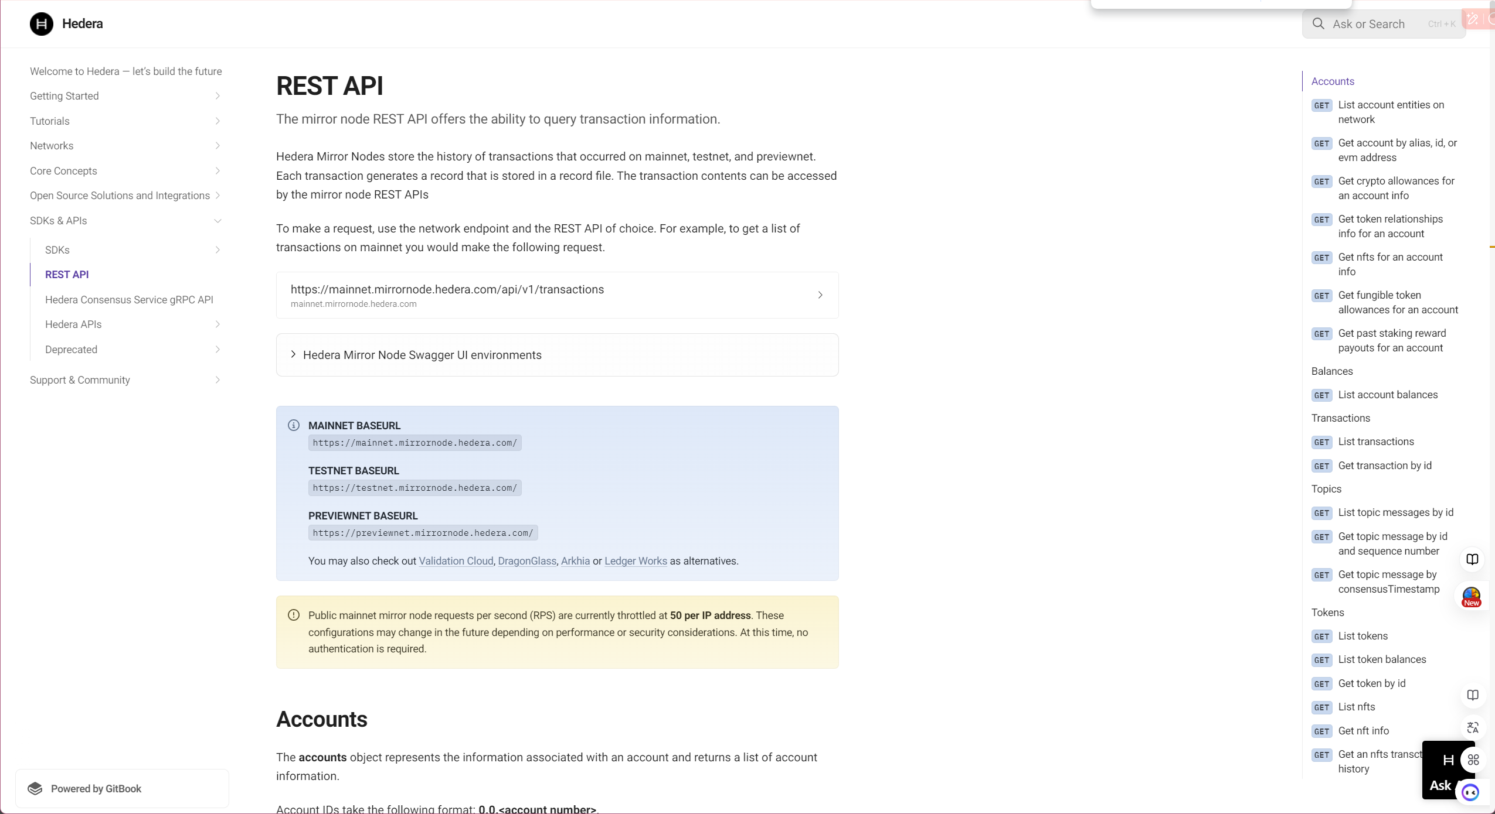
Hedera official document
Notes:
Hedera Mirror Nodes store the history of transactions that occurred on mainnet, testnet, and previewnet. Each transaction generates a record that is stored in a record file. The transaction contents can be accessed by the mirror node REST APIs. (https://docs.hedera.com/hedera/sdks-and-apis/rest-api)

Slide 22
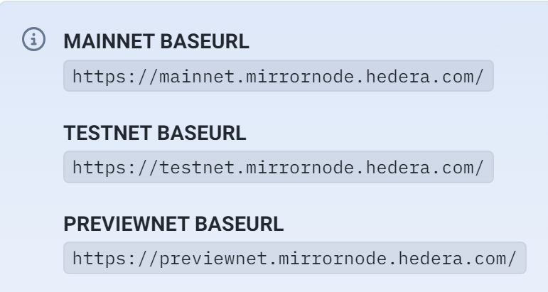
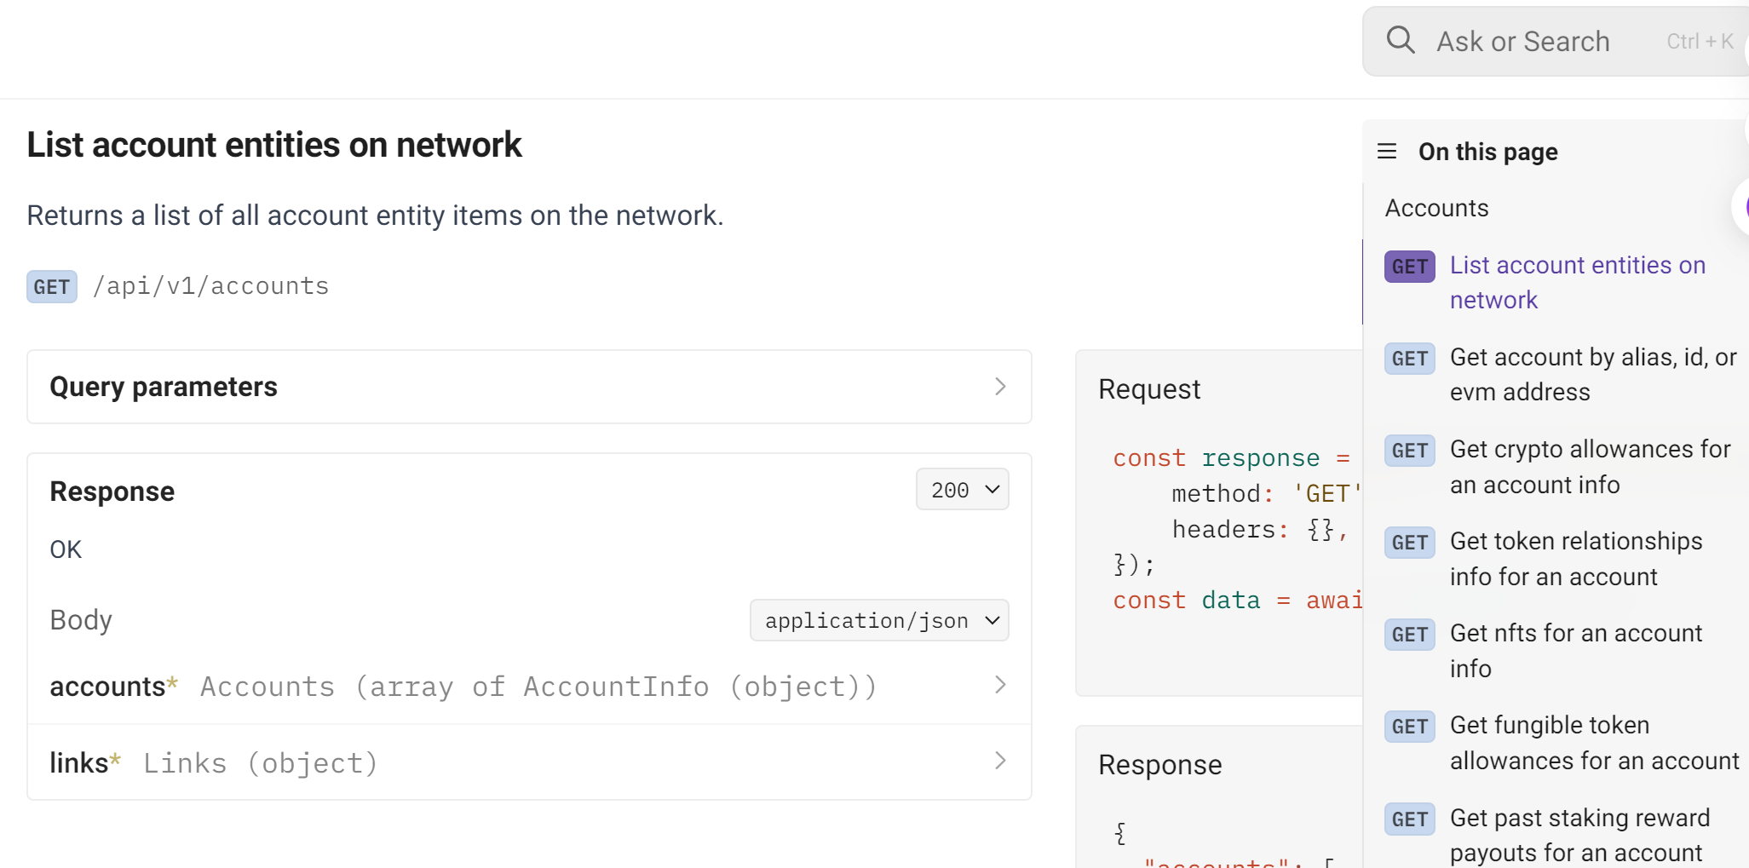
REST API USAGE
To make a request, use the network endpoint and the REST API of choice. For example, to get a list of account entity on mainnet you would make the following request
1. base url
2. Sub url
Notes:
Base_url + suburl = what you want

Slide 23
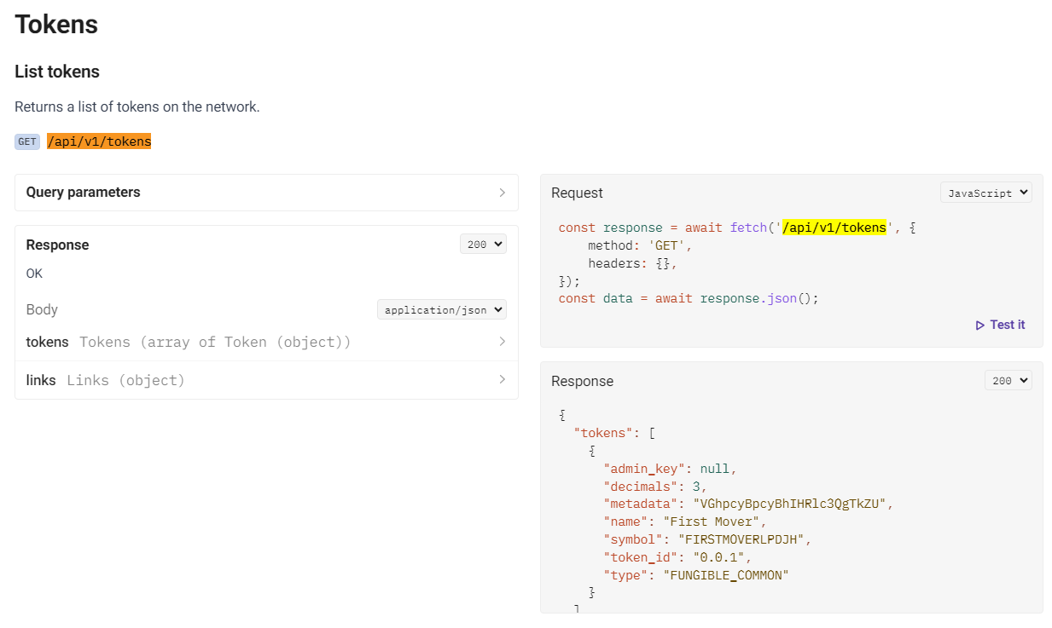
Data Acquisition Solution
/api/v1/tokens
Notes:
Get 29,011 contracts in hedera block chain, 25,811 traded

Slide 24
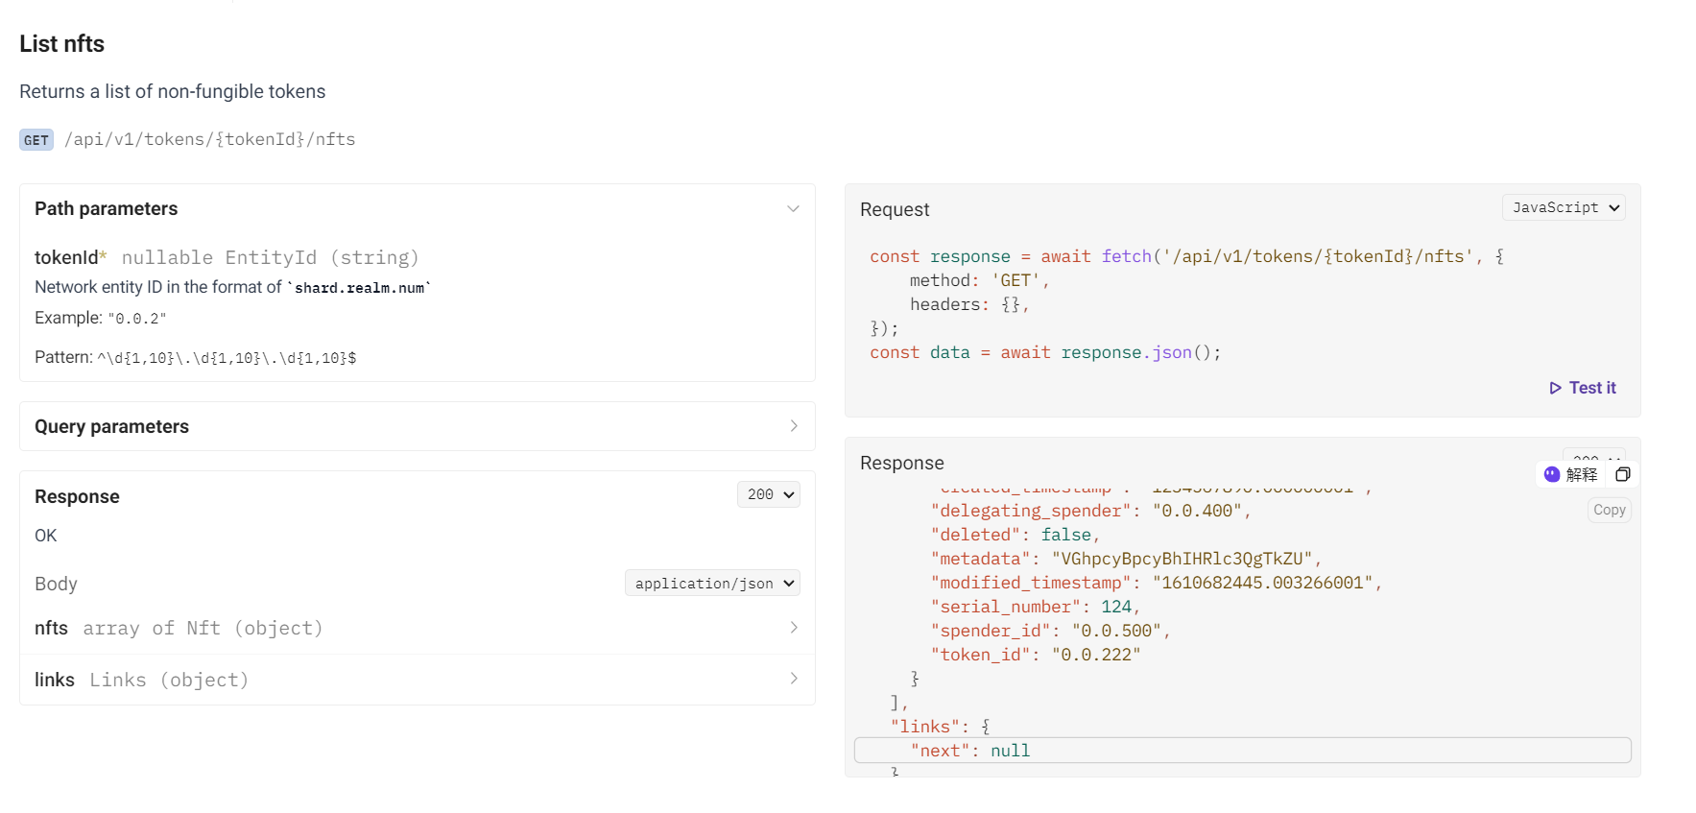
Data Acquisition Solution
/api/v1/tokens/{tokenId}/nfts
Notes:
Use token id of each contracts to get each series number of each token id

Slide 25
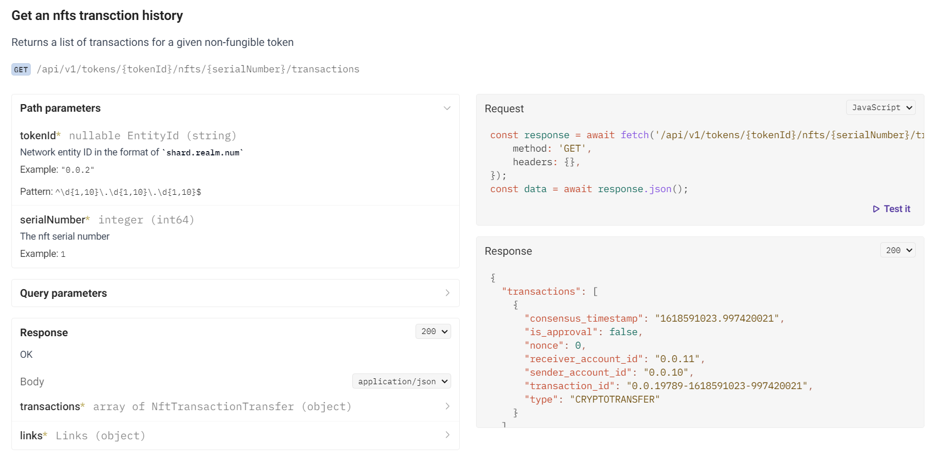
Data Acquisition Solution
/api/v1/tokens/{tokenId}/nfts/{serialNumber}/transactions
Notes:
Iterate over all the token and series number of each contract above to get the transactions (mint ,deleted , cryptos transfer,cryptos trades ) for each contract
Total 9 M + transactions records in hedera up to 2024/ 8/26

Slide 26
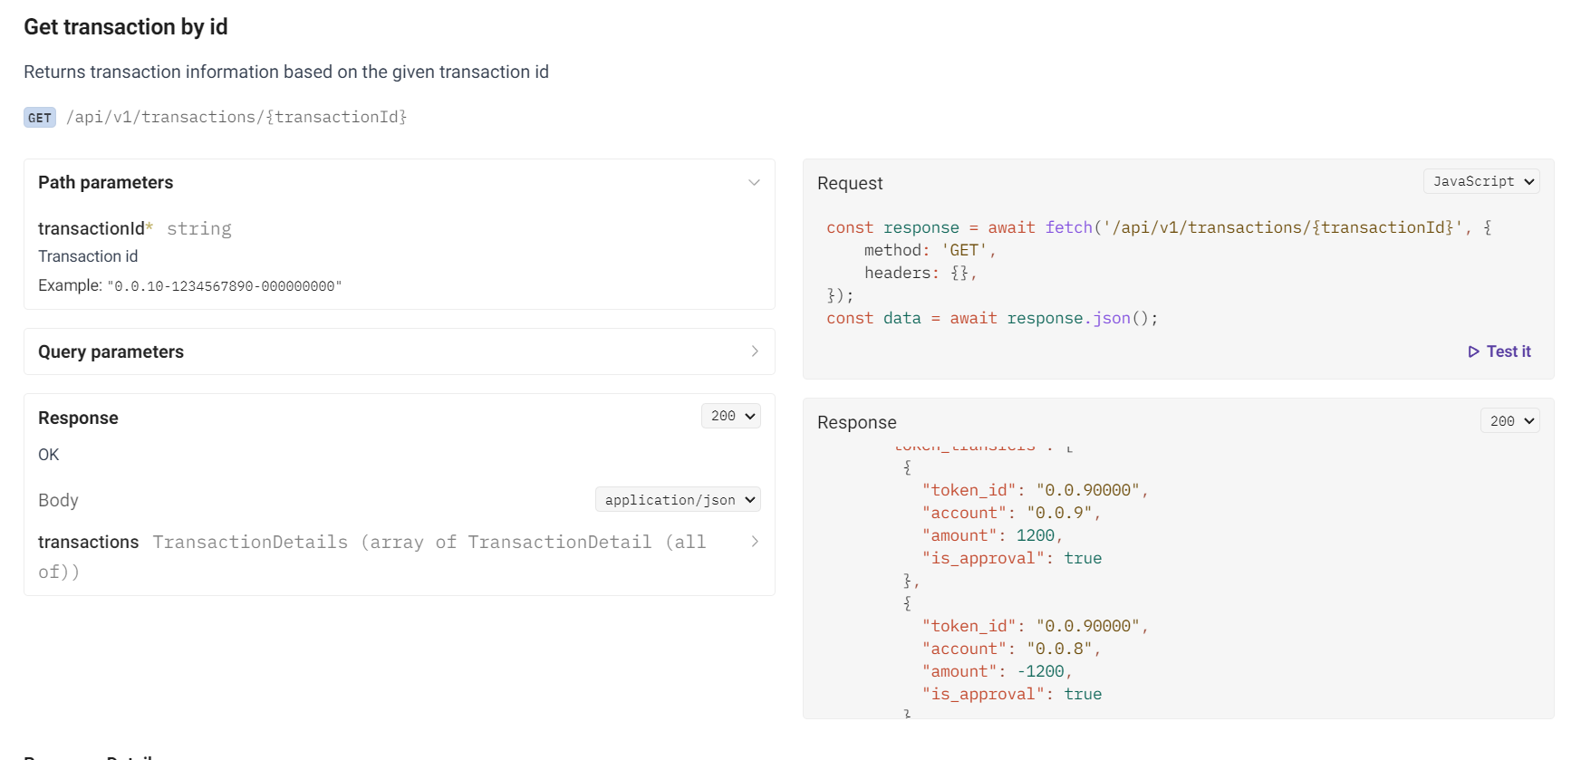
Data Acquisition Solution
/api/v1/transactions/{transactionId}
Notes:
Use the transaction hash to get sender and receiver details accounts detail in the transaction ，Get the Top 10 volumes contracts detail and to calculate the concentration index ,comparison data and so on

Slide 27

The whole Data solation Flow chart
caculation
index
business
Ethereum
compason
All contract tokens
All the series numbers of each contract
Transaction details, Transaction account detail
hedera
node
api1
api2
api3
daily maintaince
Traders
Hedera
report
Newbies
Notes:
flow diagram

Slide 28
Field different
Filed name | Description
consensus timestamp | The consensus timestamp in seconds.nanoseconds
transaction hash | The hash value of the transaction processed on the Hedera network
valid start timestamp | The time the transaction is valid
charged tx fee | The transaction fee that was charged for that transaction
transaction id | The ID of the transaction
memo base64 | The memo attached to the transaction encoded in Base64 format
result | Whether the cryptocurrency transaction was successful or not
entity ID | The entity ID that is created from create transactions (AccountCreateTransaction, TopicCreateTransaction, TokenCreateTransaction, ScheduleCreateTransaction, ContractCreateTransaction, FileCreateTransaction).
name | The type of transaction
max fee | The maximum transaction fee the client is willing to pay
valid duration seconds | The seconds for which a submitted transaction is to be deemed valid beyond the start time. The transaction is invalid if consensusTimestamp is greater than transactionValidStart + valid_duration_seconds.
node | The ID of the node that submitted the transaction to the network
transfers | A list of the account IDs the crypto transfer occurred between and the amount that was transferred. A negative (-) sign indicates a debit to that account. The transfer list includes the transfers between the from account and to account, the transfer of the node fee, the transfer of the network fee, and the transfer of the service fee for that transaction. If the transaction was not processed, a network fee is still assessed.
token transfers | The token ID, account, and amount that was transferred to by this account in this transaction. This will not be listed if it did not occur in the transaction
assessed custom fees | The fees that were charged for a custom fee token transfer
links.next | A hyperlink to the next page of responses

Slide 29
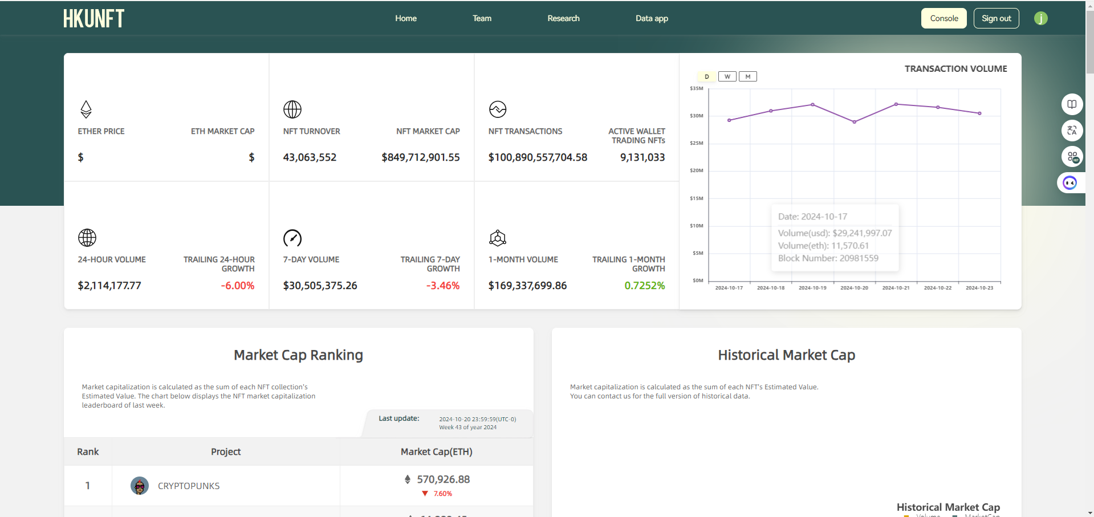
HKU NFT HOME PAGE
Notes:
https://hku-nft.com/

Slide 30
achievements
All-in-one NFT Data Analysis Platform
Get 29011 contract
Get 9M+ transaction records
Get top 10 NFT transaction detail
data comparison : Ethereum vs Hedera

Slide 31
Why HKU-NFT?
All-in-one NFT Data Analysis Platform
Comprehensive Data Insights
Customized Data Dashboard
Outstanding Academic Contributions
Top Academic & Development Team

Slide 32
All-in-one NFT Data Analysis Platform
On-Chain Data
HKU NFT Data Analysis Platform
Developers
HKU-NFT
API
OpenSea
Raw Data
Filtered Data
Key Metrics
Blur
HKU-NFT
Dashboard
Analysts
X2Y2
Web3
Node
Logs
Topic
Token_id
Transfer
Address
Volume
Market Cap
Strike Price
Transactions
Active Wallets
Minting
...
LooksRare
Cleaned
Augmented
HKU-NFT
Weekly Report
Traders
Zora
HKU-NFT
Lecture
Newbies

Slide 33
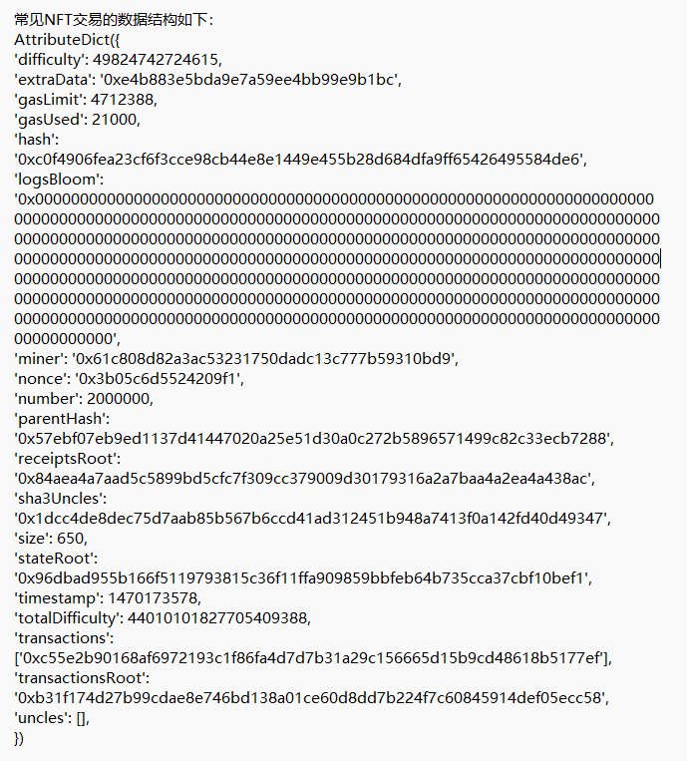
Comprehensive Data Insights
Key Metrics Extraction:
Analyzing critical data directly from the blockchain.
miner
parentHash
gasLimit
gasUsed
difficulty
extraData
hash
gasLimit
nonce
stateRoot
logsBloom
hash
extraData
sha3Uncles
timestamp

Slide 34
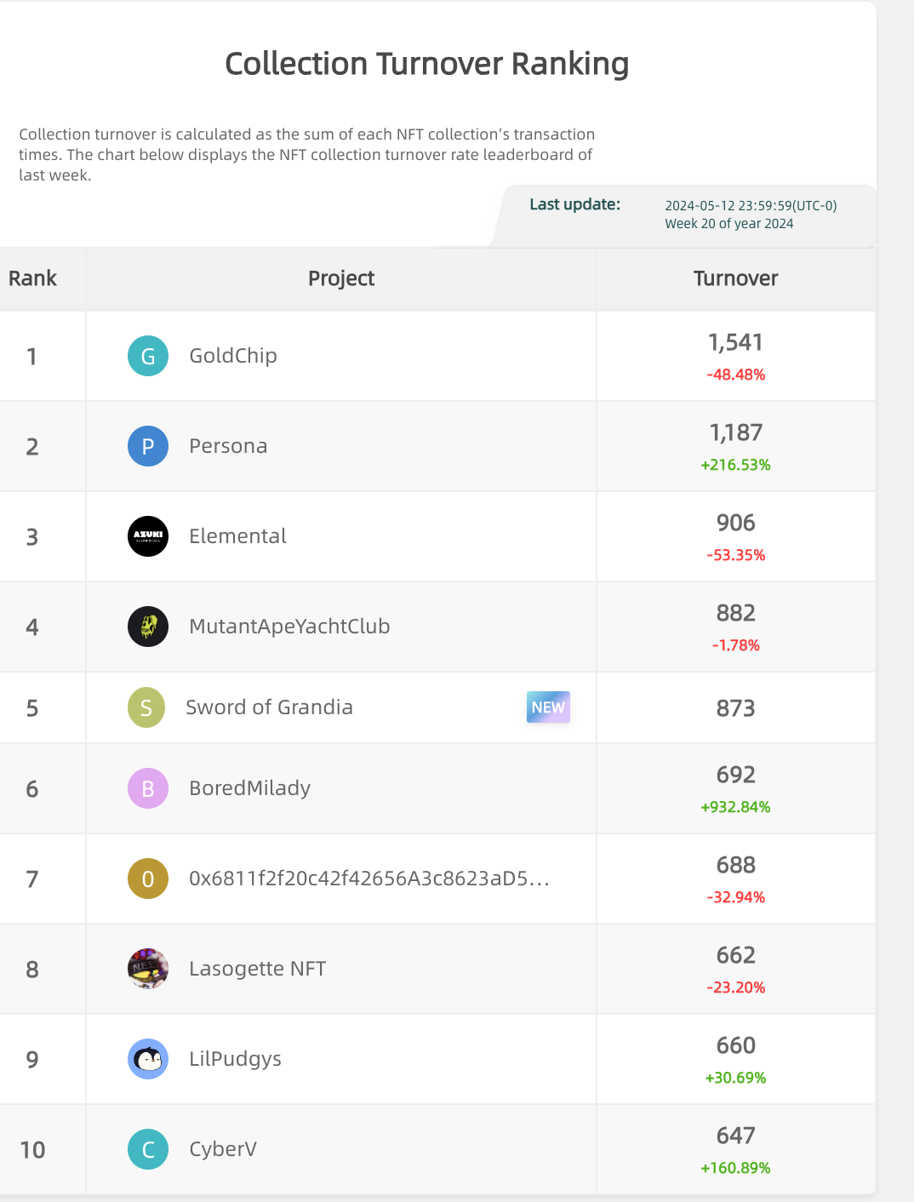
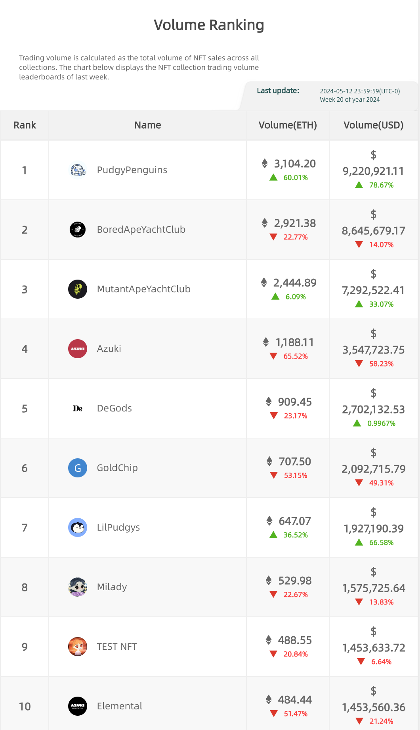
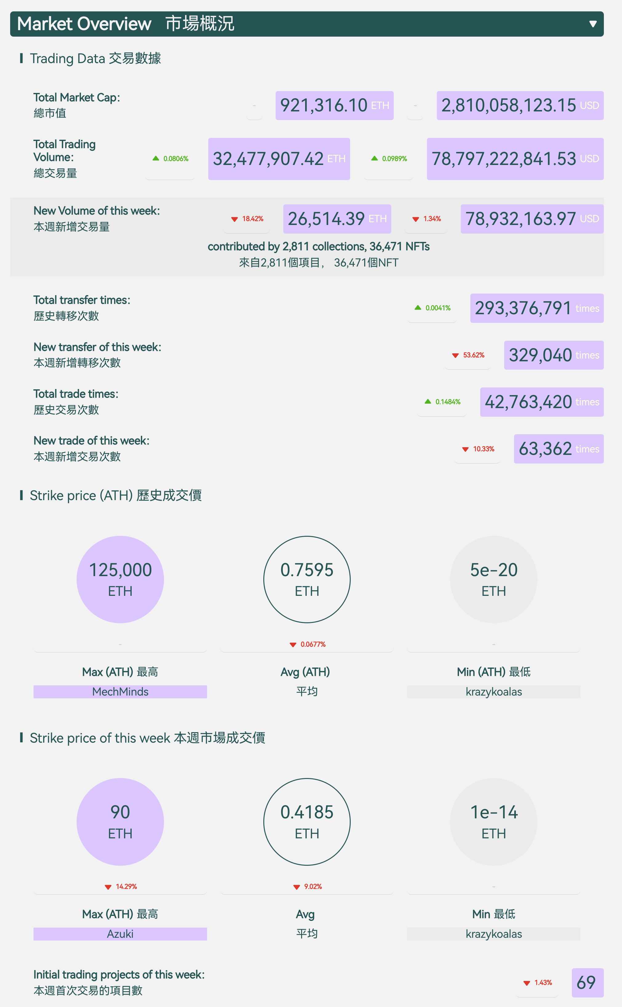
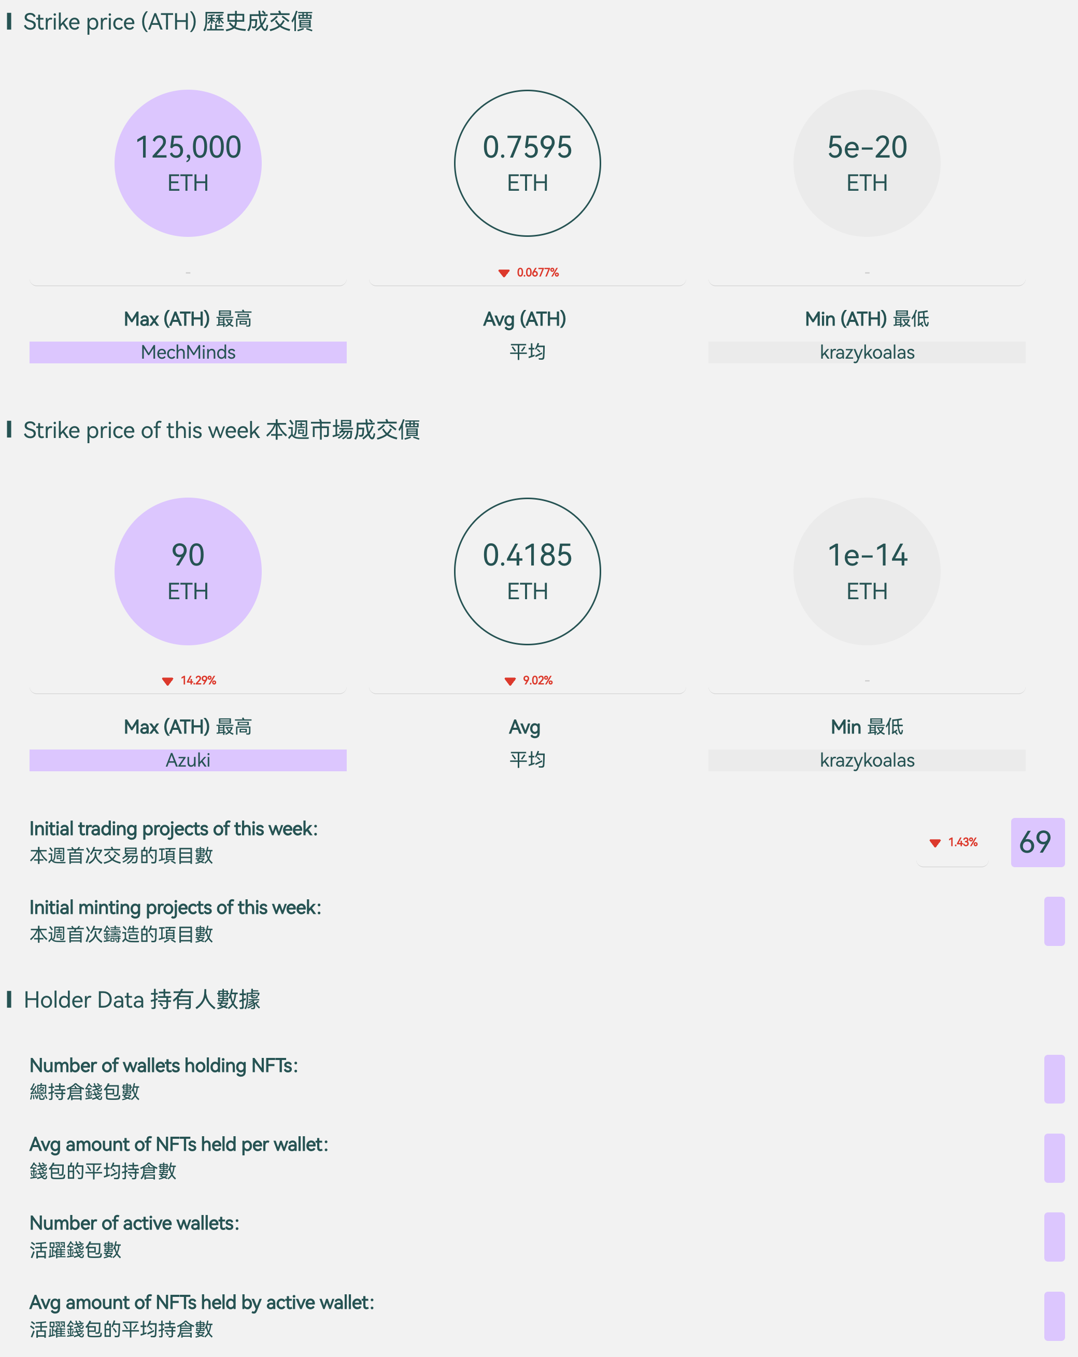
Comprehensive Data Insights
Financial Indicator Analysis:
Market Overview
Trading Volume
On-chain Transactions
Turnover

Slide 35
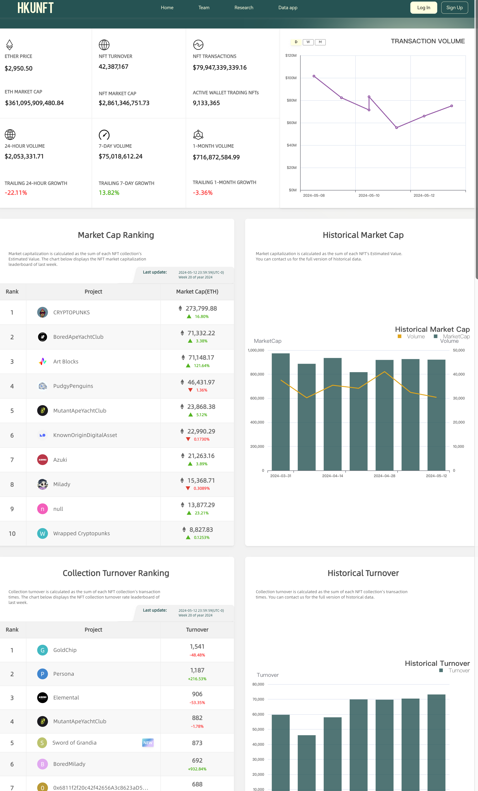
Customized Data Interface
NFT Data Dashboard
All-in-One View
Rankings & Trends
In-Depth Analytics

Slide 36
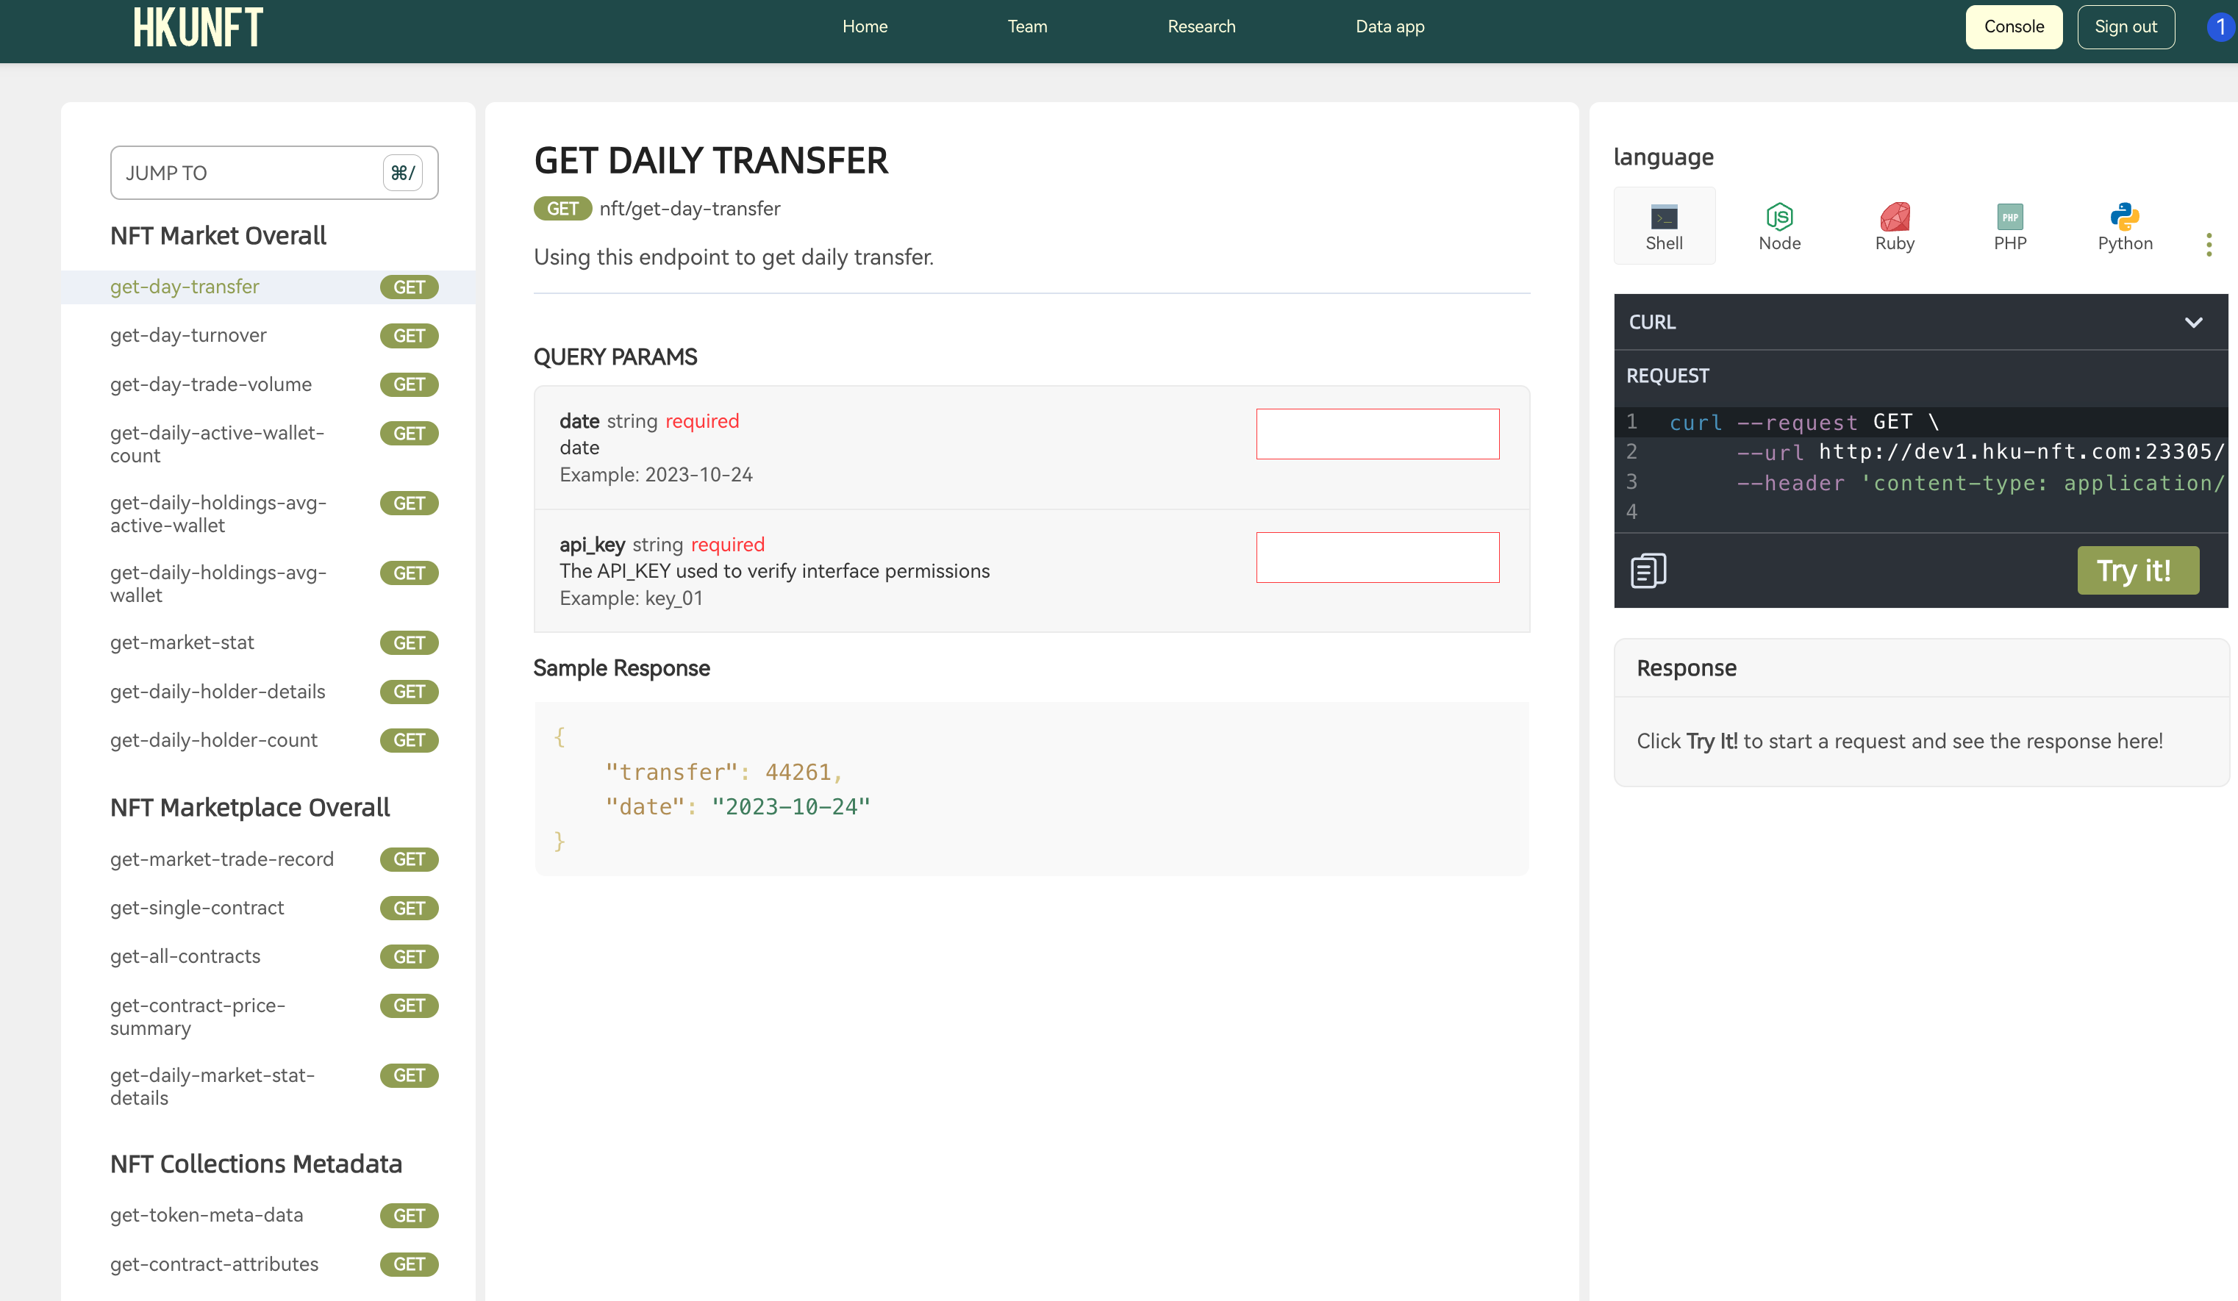
Customized Data Interface
APIs for Pro
Personalized API Keys
Seamless Integration

Slide 37
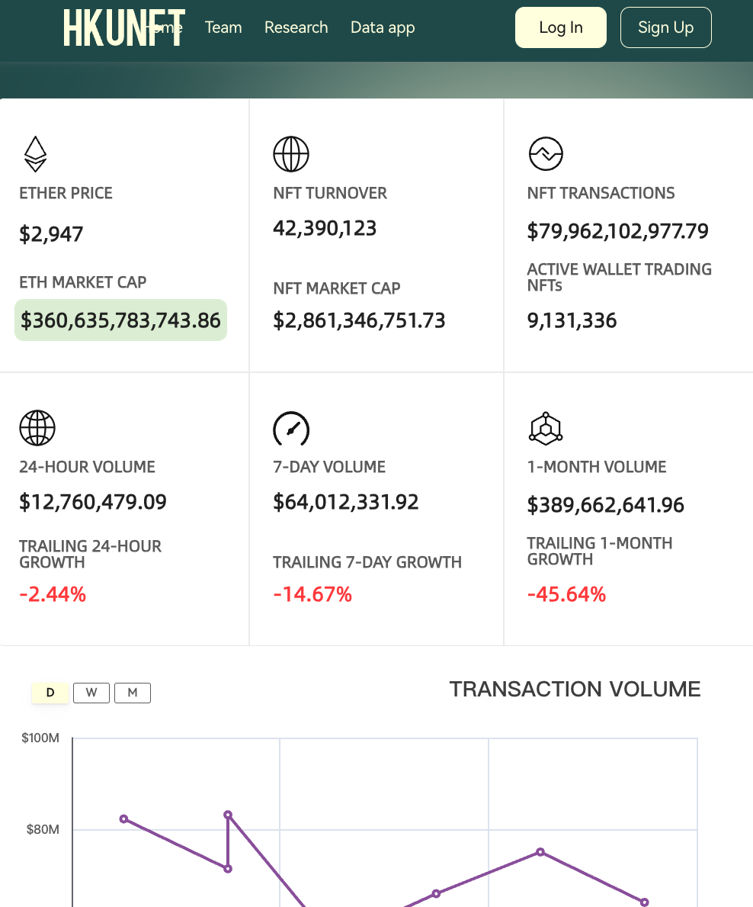
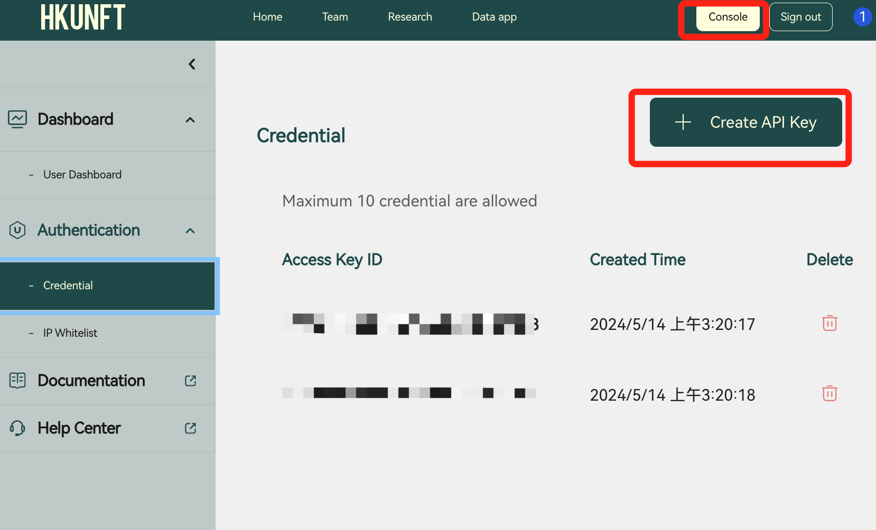
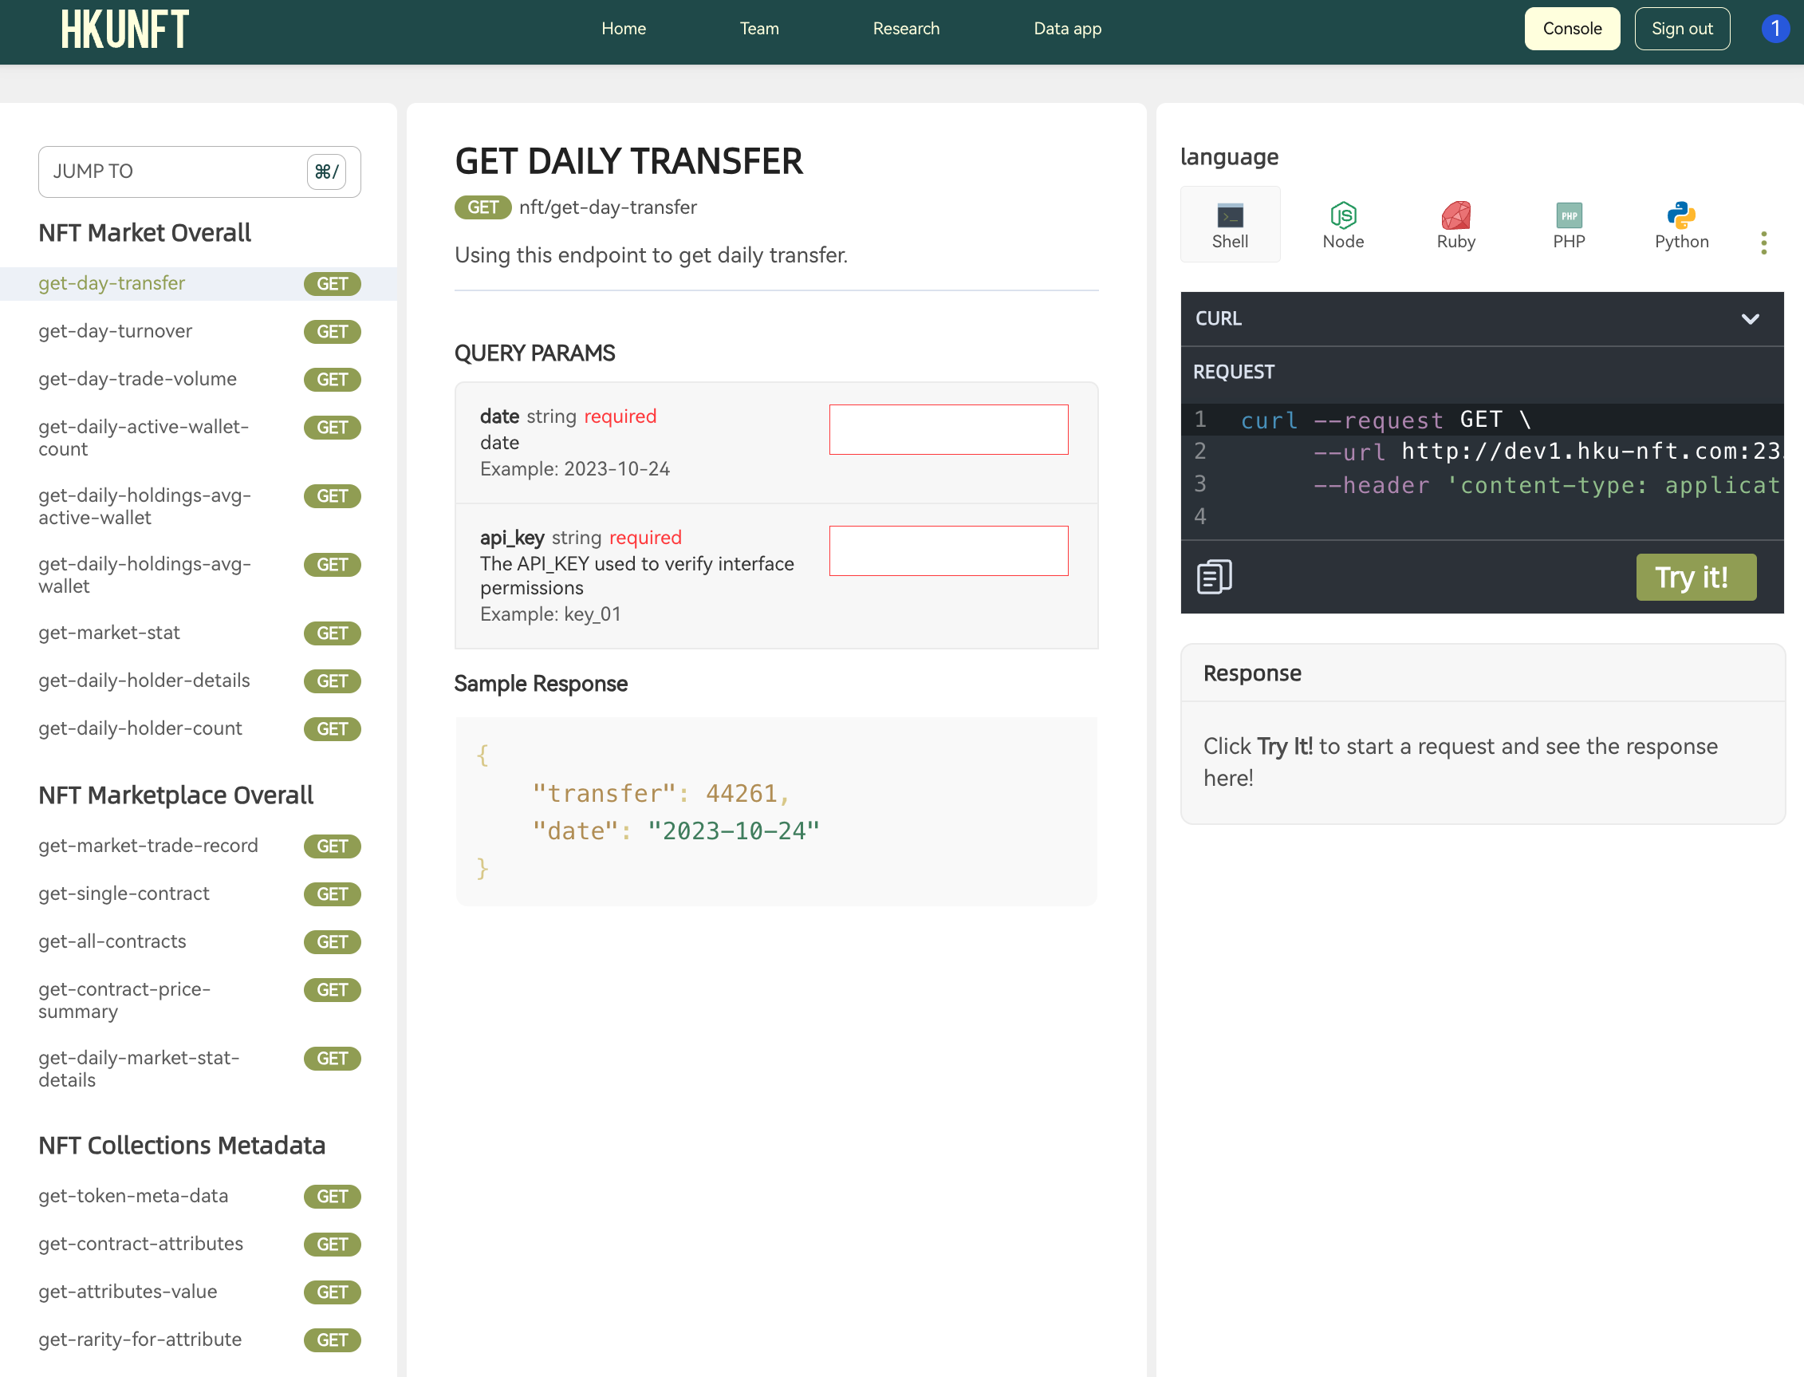
Customized Data Interface
APIs for Pro - A Step by Step Guide
1. Sign in
2. Enter the console and create your API key(keep it safe!)
3. Get cleaned NFT data

Slide 38
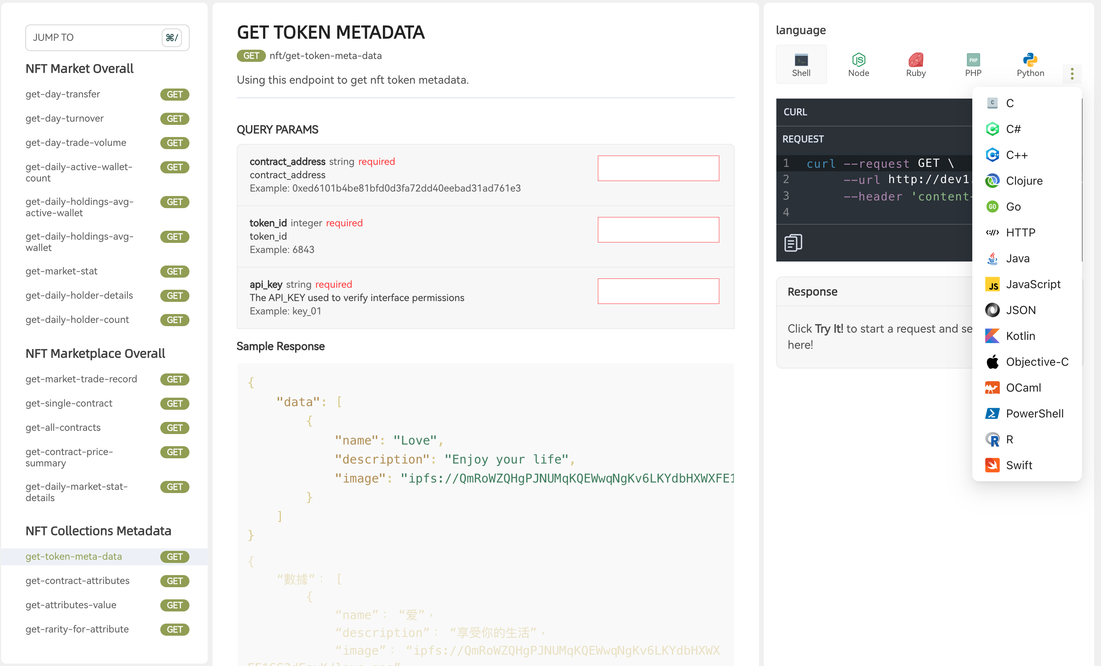
Customized Data Interface
APIs for Pro
20 Languages
18 Mtetrics
Filtered, Cleand, Augmented.

Slide 39
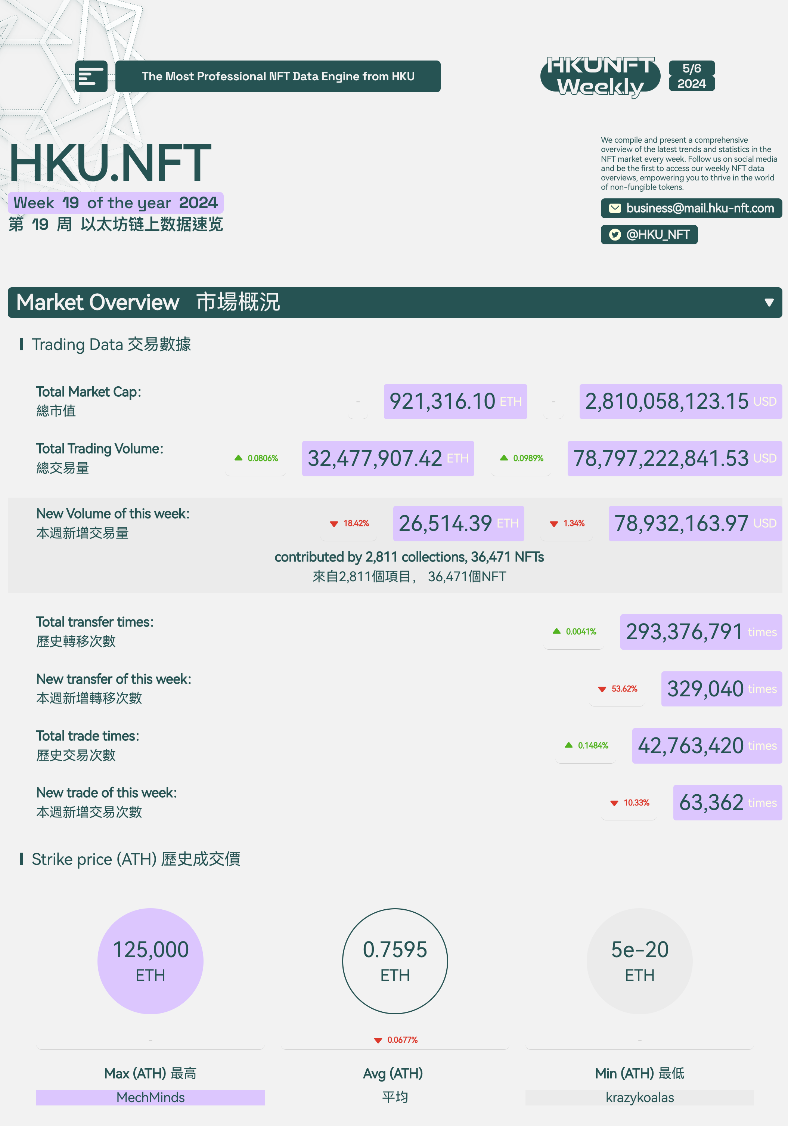
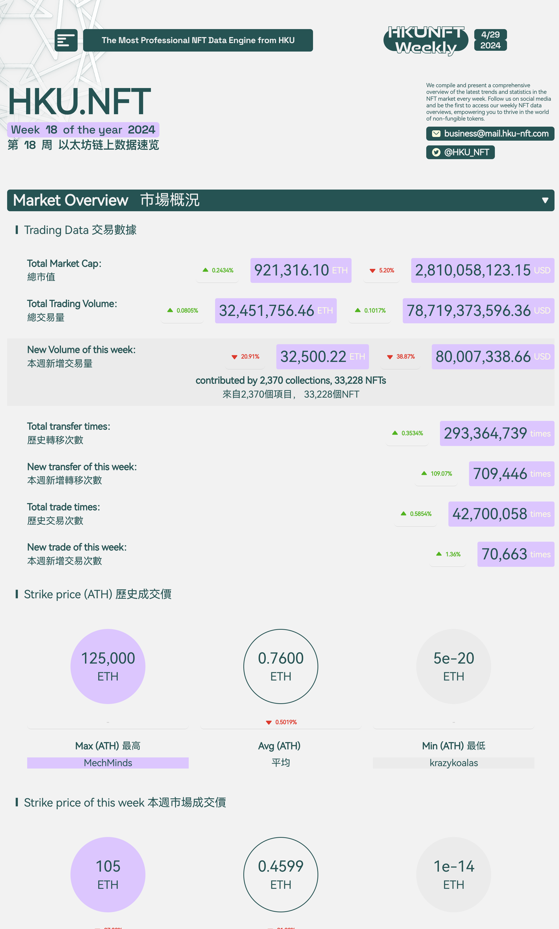
Customized Data Interface
In-depth Weekly NFT Report
Comprehensive Market Overview
Actionable Insights
Stay Ahead
Ideal for Decision-Makers

Slide 40
Outstanding Academic Contributions
Research Team & Publications
Our dataset, offering comprehensive and highly reliable NFT transaction data, is an invaluable resource for researchers. With clean and accurate data covering the majority of NFT transactions, it significantly streamlines academic research.

Slide 41
Outstanding Academic Contributions
Educational Curriculum Collaboration
For CS/Fintech:
Comprehensive blockchain technology theory
Smart contract development and DApp creation
Advanced blockchain/NFT data analysis
Computer vision for NFT image analysis and rarity assessment
For Finance/Business:
Fundamental blockchain theory
Practical blockchain applications
Blockchain/NFT data analysis from a financial perspective

Slide 42
Vision & Mission
Building Long-term Partnerships with Universities
Providing Comprehensive API Services for Institutions
Contributing Cutting-Edge Databases to Academia
Exchanging Knowledge and Resources with Schools
Cultivating Blockchain Talent

Slide 43
NFT Data Extract Analysis
Content
Analysis Method
Fund Transfer
Trading Record
Marketplace Contract
Analysis Tool
Result Understanding

Slide 44
Content
Analysis Method
Fund Transfer
Trading Record
Marketplace Contract
Analysis Tool
Result Understanding

Slide 45
Fund Transfer Analysis
Native Token: ETH
ERC20 Token: USDT, USDC, WETH...
Native Token | ERC20 Token
Defined by Blockchain | Defined by Smart Contract
Transfer by sending Ethereum transactions | Transfer by calling contract functions
Recorded in every transaction | Recorded in contract logs
Created when mining | Created according to the contract code

Slide 46
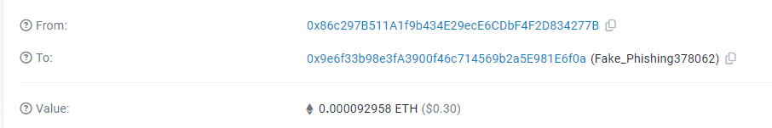
Example: ETH Transfer
Sender: 0x86c297B511A1f9b434E29ecE6CDbF4F2D834277B
Receiver: 0x9e6f33b98e3fA3900f46c714569b2a5E981E6f0a
Transfer: 0.000092958 ETH
Data can be found in transaction fields
Transaction Hash: 0x335f01c6ace6cc9e686c6a6a63c0fd95e7f29ba23ca3f12481e9a29953363236

Slide 47
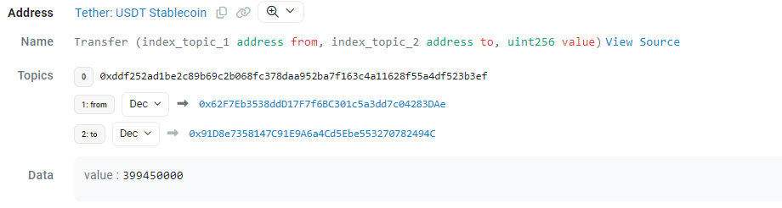
Example: ERC20 Transfer
Sender: 0x62F7Eb3538ddD17F7f6BC301c5a3dd7c04283DAe
Receiver: 0x91D8e7358147C91E9A6a4Cd5Ebe553270782494C
Transfer: 399.45 USDT
Data can be found in transaction log
Transaction Hash: 0x47e4e9ae3767a7d60203a0f64ef081b0d9fa366c03e9569fb9db5ca4ac9682ef

Slide 48
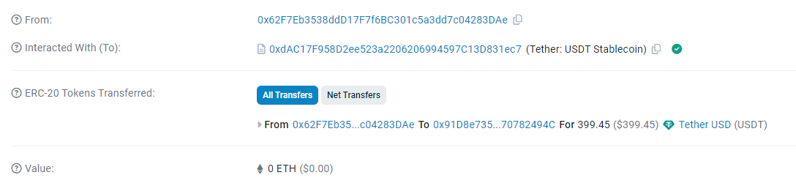
Transaction field:
To: the ERC20 token address
Value: 0 (otherwise “from” address will send ETH to the contract address)

Slide 49
NFT Trading Record
NFT transfer record can be located similar to ERC20
But trading record can only be found in the marketplace contract

Slide 50


Smart Contract Analysis
Every NFT marketplace deploys one or several smart contracts on chain
These smart contracts perform the core trading logics (e.g. price matching, fund transfer, transaction fee, ...)
1. Call Buy function
Transfer ETH from buyer
Buyer
2. Contract activate fund transfer (according to contract code)
Transfer NFT from seller
Emit Buy event
function Buy
Buy Log (Buyer, Seller, price)
Seller
Marketplace contract

Slide 51
Trading data is located in:
1. Event Log
Every trading record has a coresponding event log
Data field defined by the marketplace contracts
Some data needed may be missing as the contract does not include them
All event logs are visible
2. Function input
Should contain every piece of information to initiate a trade
Some data may need to refer to the contract’s member variable
Function input may be invisible because of recursive call
Both method need a certain degree of inference according to the contract logic to extract relevant data

Slide 52
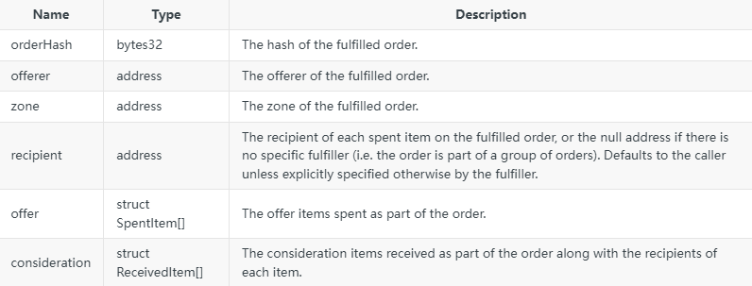
Example: Opensea Seaport
Key event: Orderfulfilled
‘offerer’ spends the items in ‘offer’ to recipient in return of ‘consideration’

Slide 53
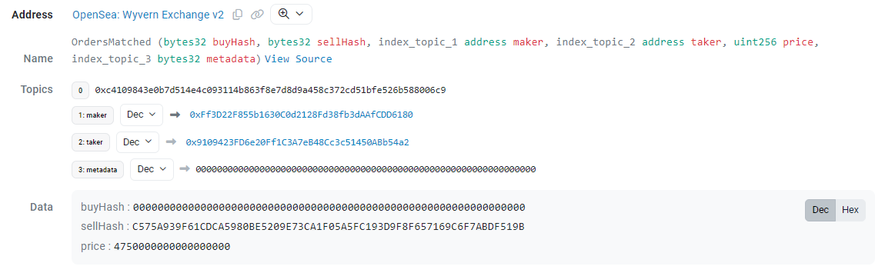
Example: Opensea Wyvern Protocol
Only one event emitted from the market place contract
No NFT data inside
Solution: Input data / NFT transfer log
Transaction Hash: 0x474ae3af949afc3304d885458c3da83e1ce63bbafd4559531a464713e4c87a42

Slide 54
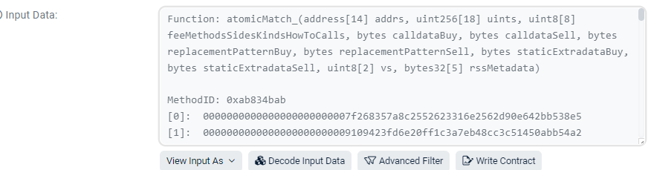
NFT data
Input data example
Why not referring to NFT log
Because log can be complicated when the function is called internally by another contract

Slide 55
Thank you!

